Slide 1
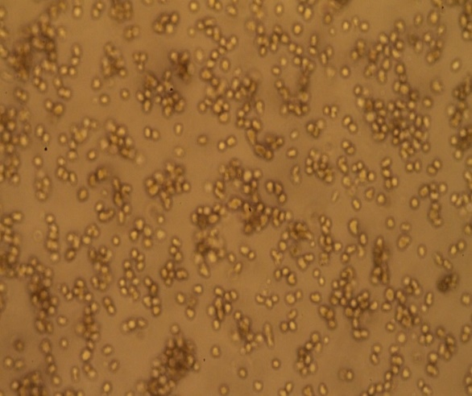
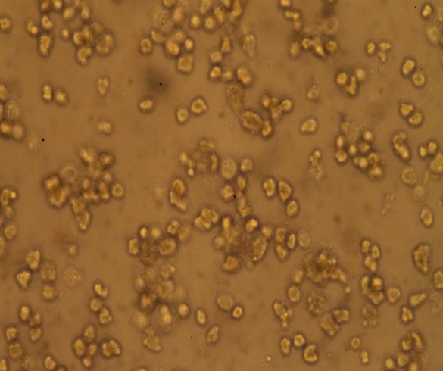
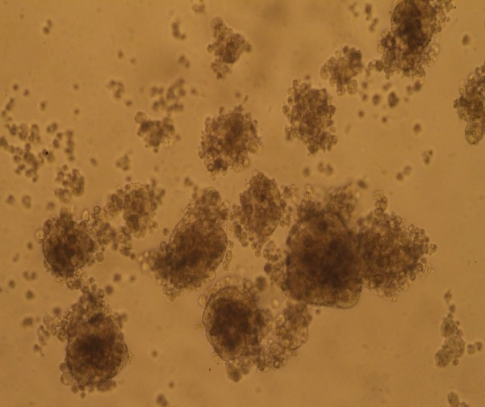
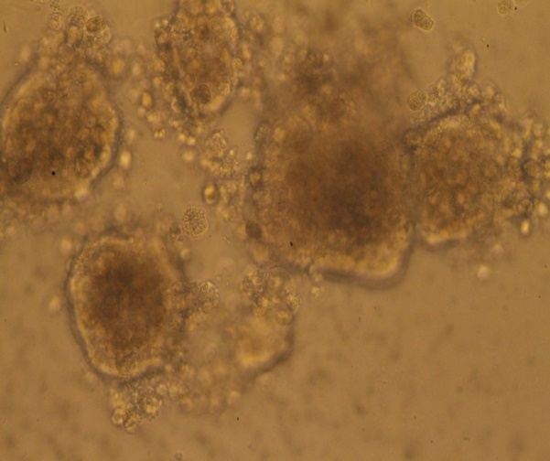
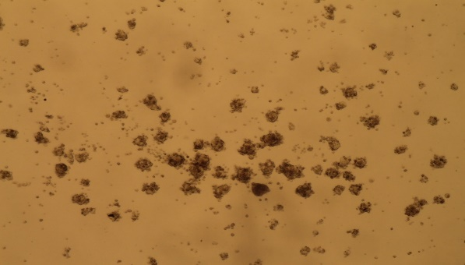
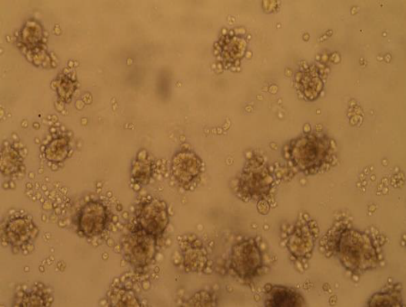
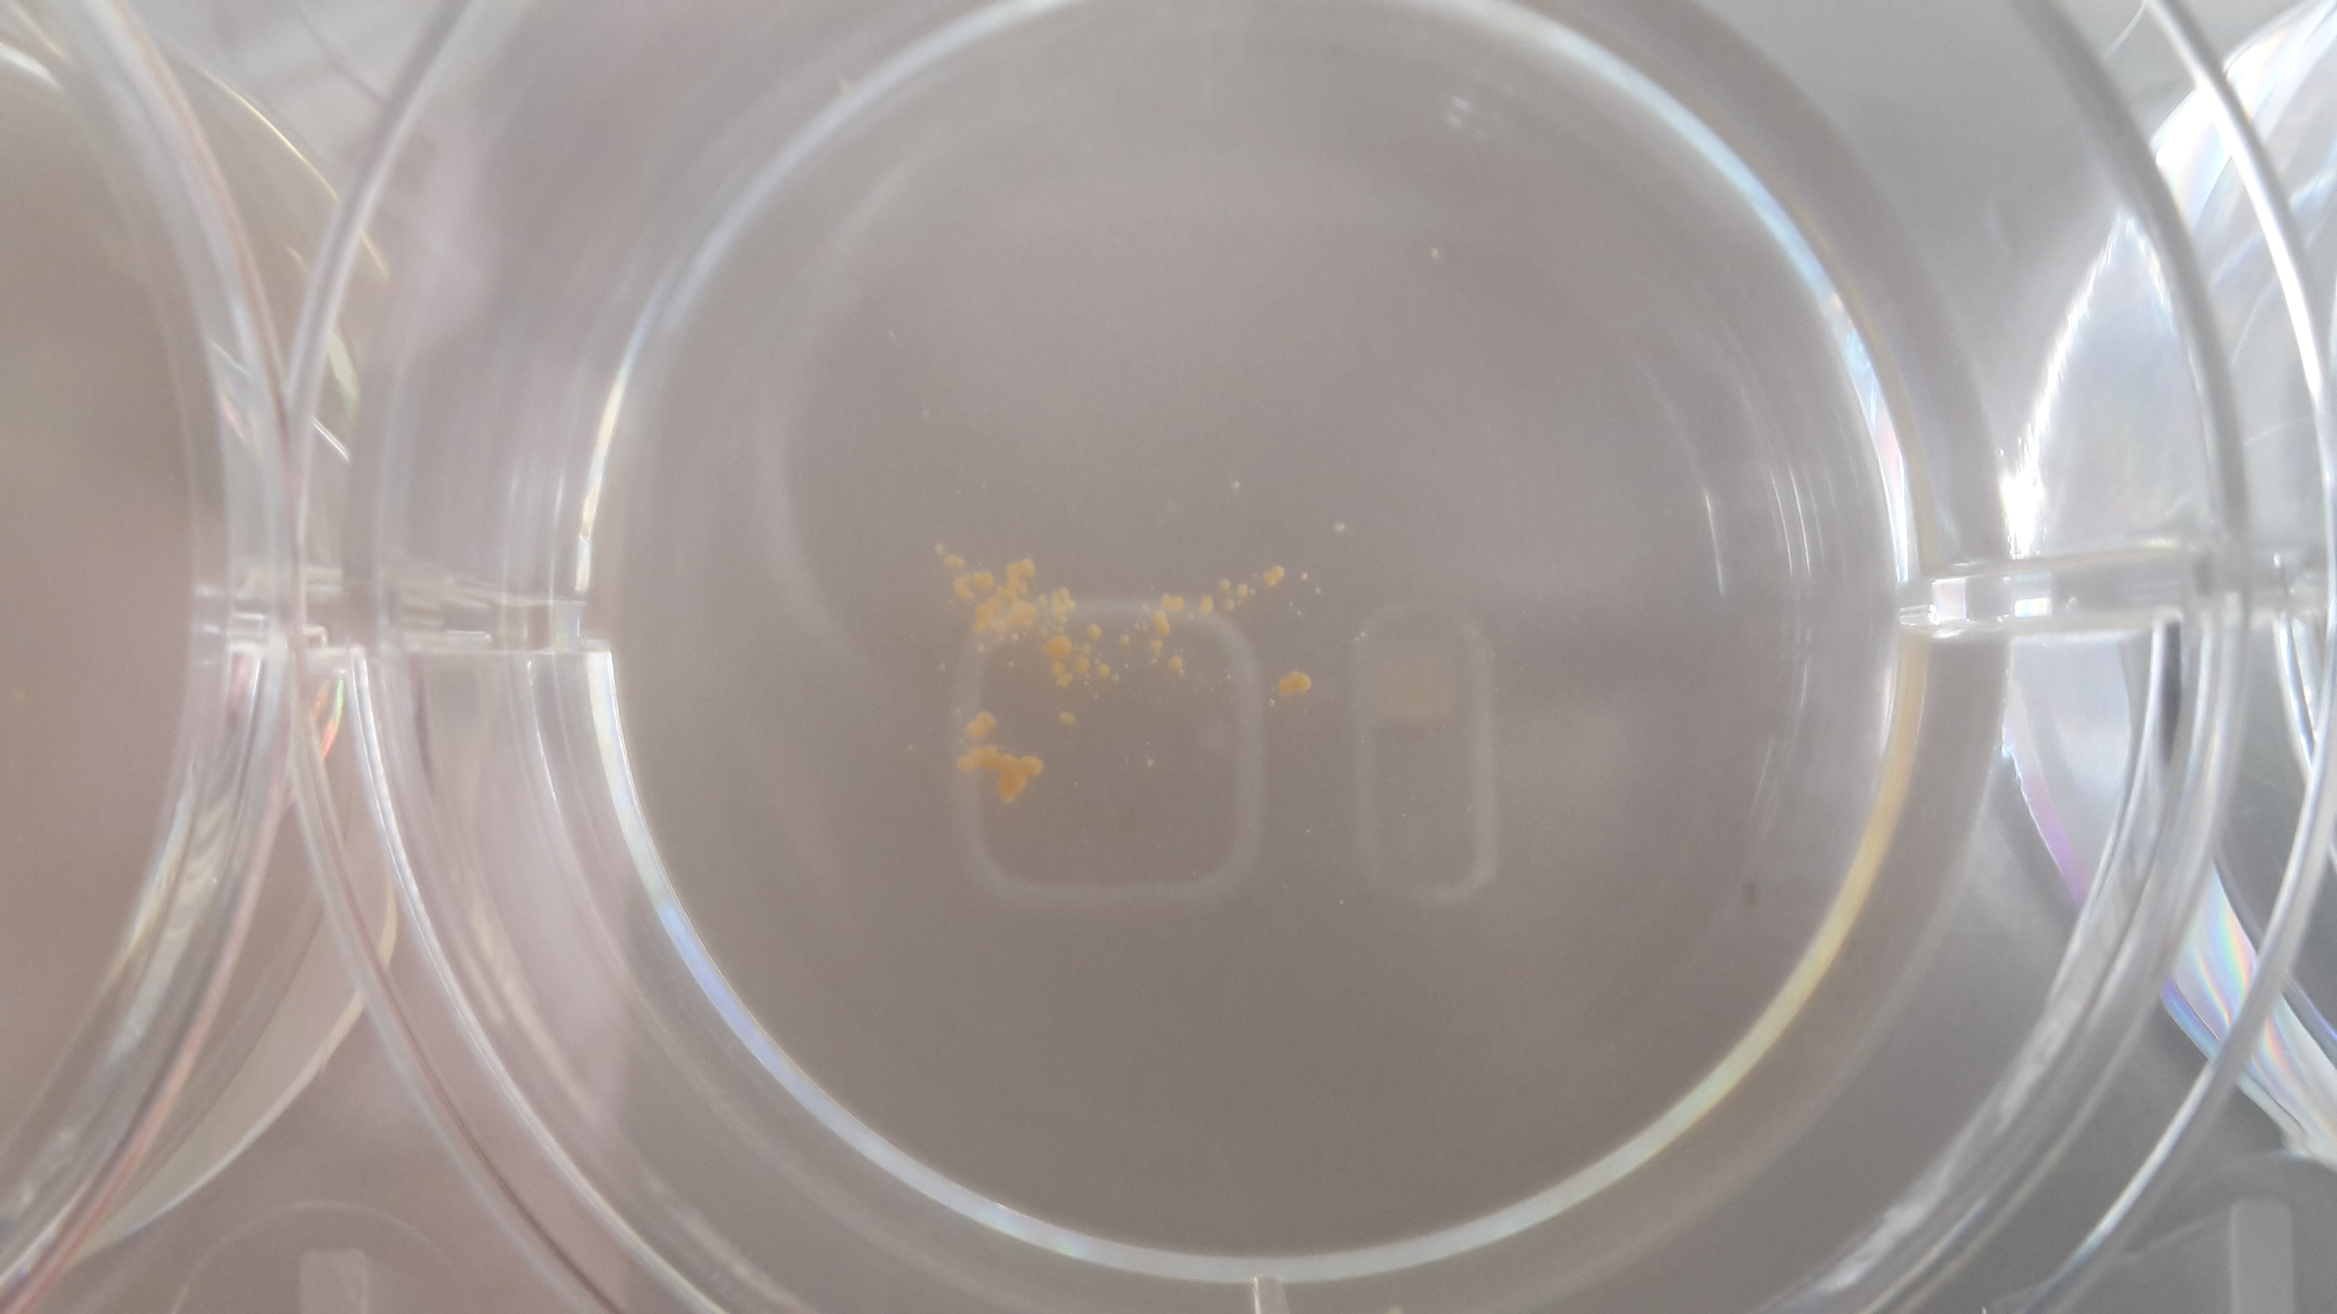
A
B
C
D
Figure 1

Slide 2
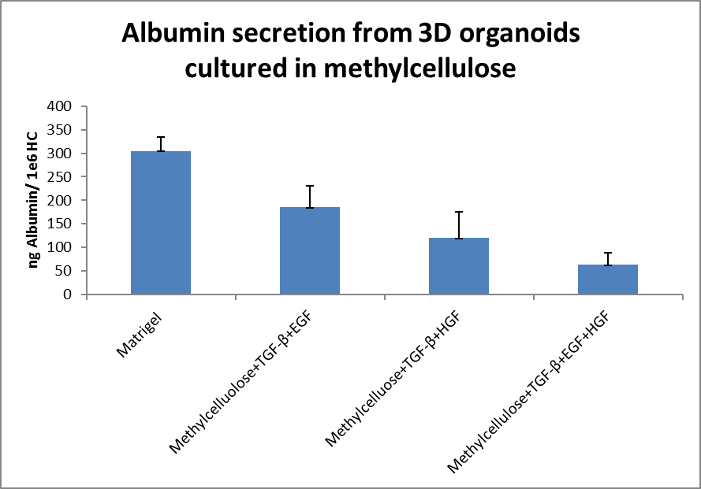
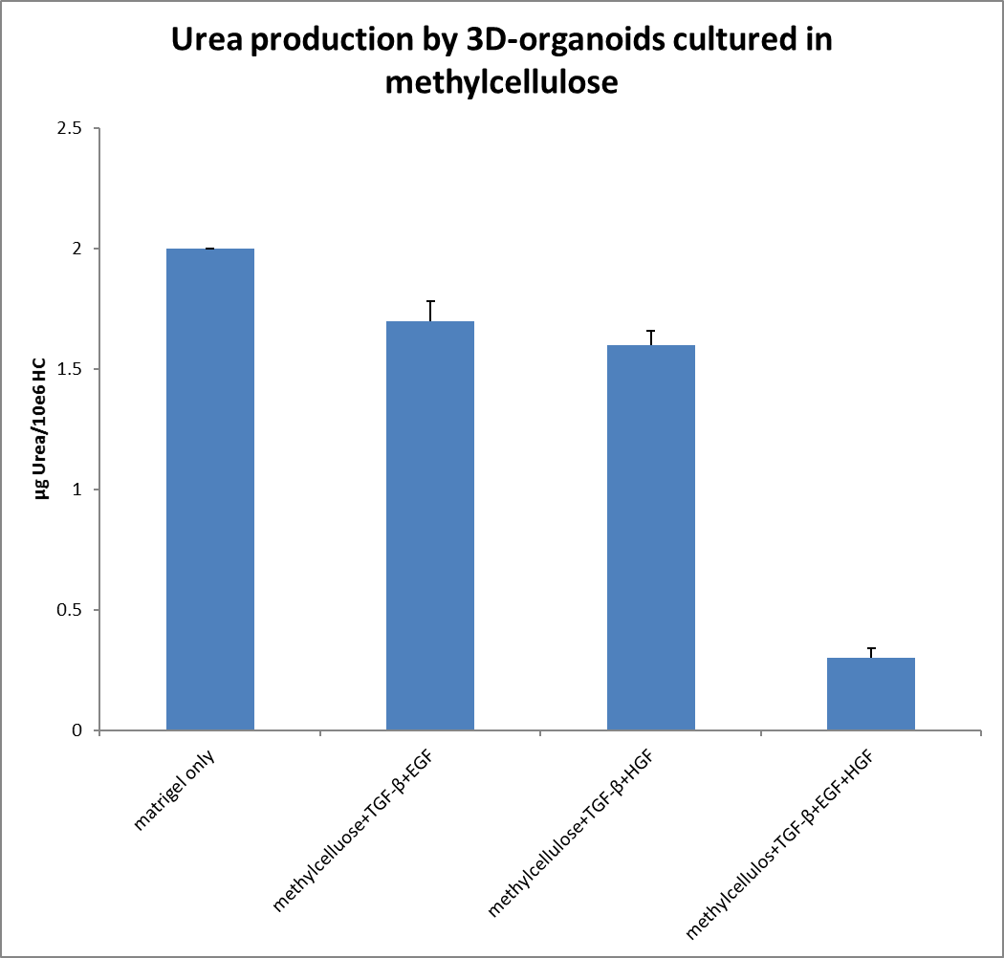
A
B
Figure 2

Slide 3
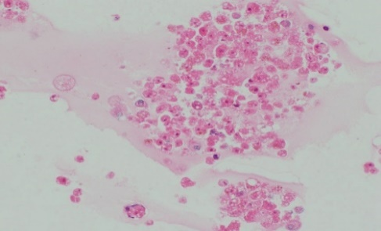
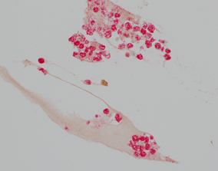
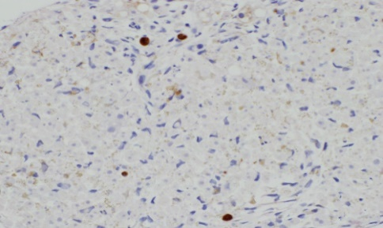
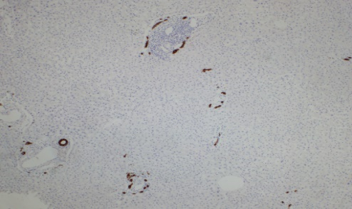
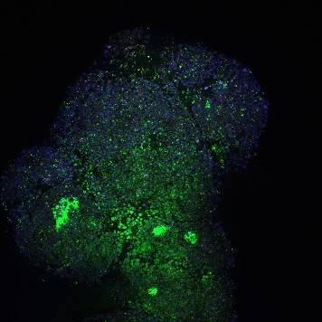
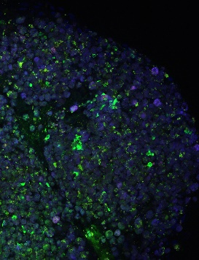
A
H&E
OCH1E5
CK-7
B
CK19
CK19
Liver Biopsy (control): CK19
C
Figure 3

Slide 4
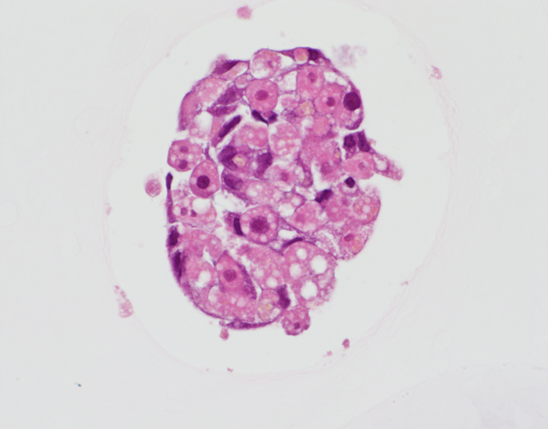
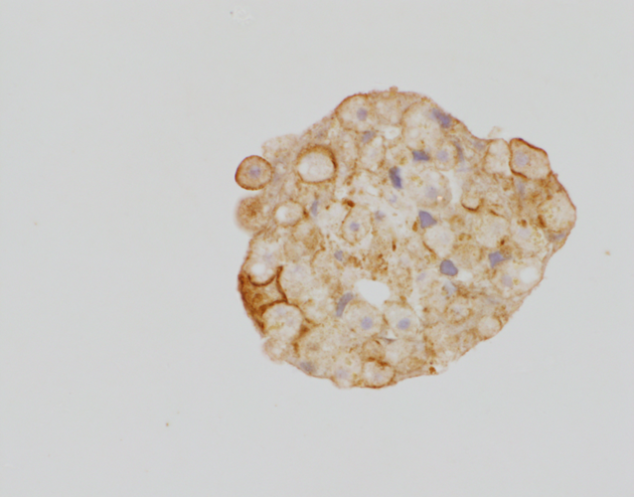
A
B
AC5: H&E
AC05: MRP2
Liver Biopsy (control): MRP2
C
Figure 4

Slide 5
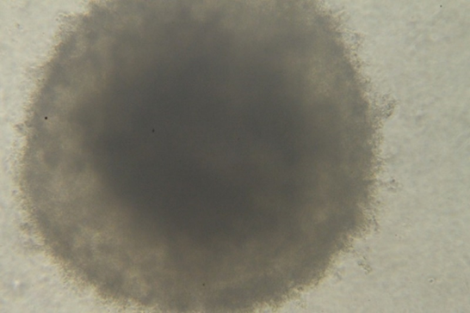
A
B
Figure S1

Slide 6
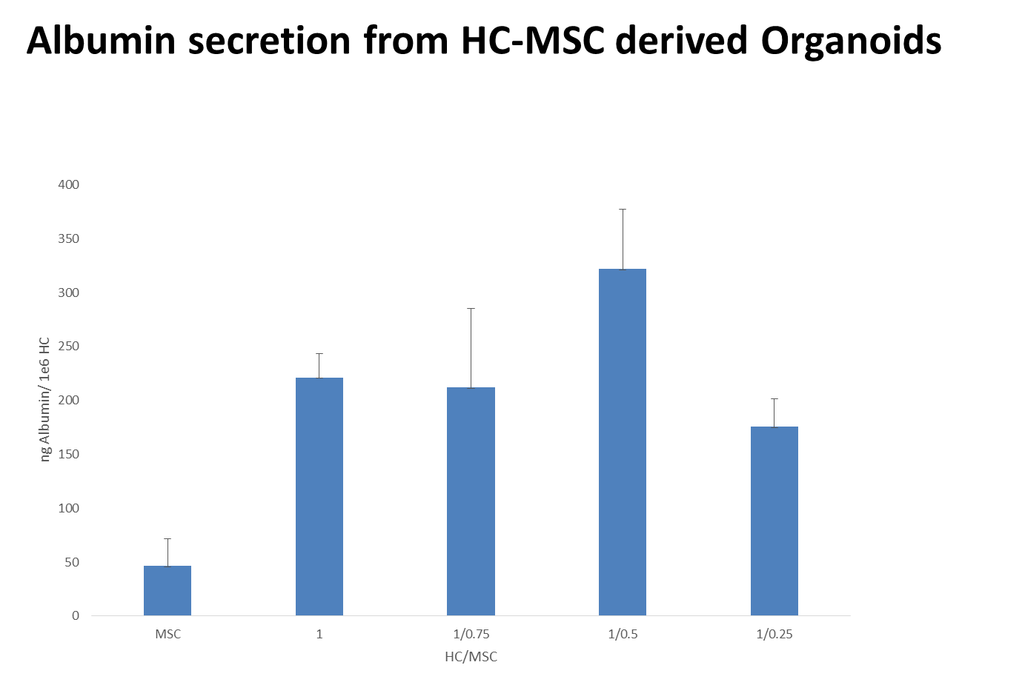
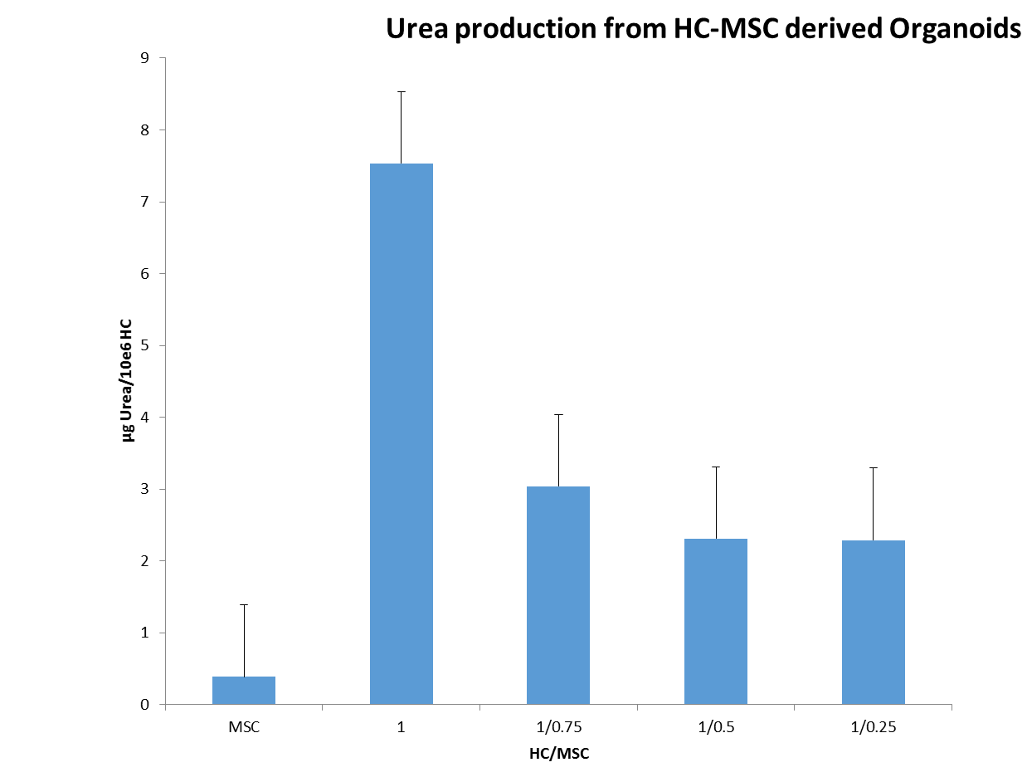
A
B
Figure S2

Slide 7
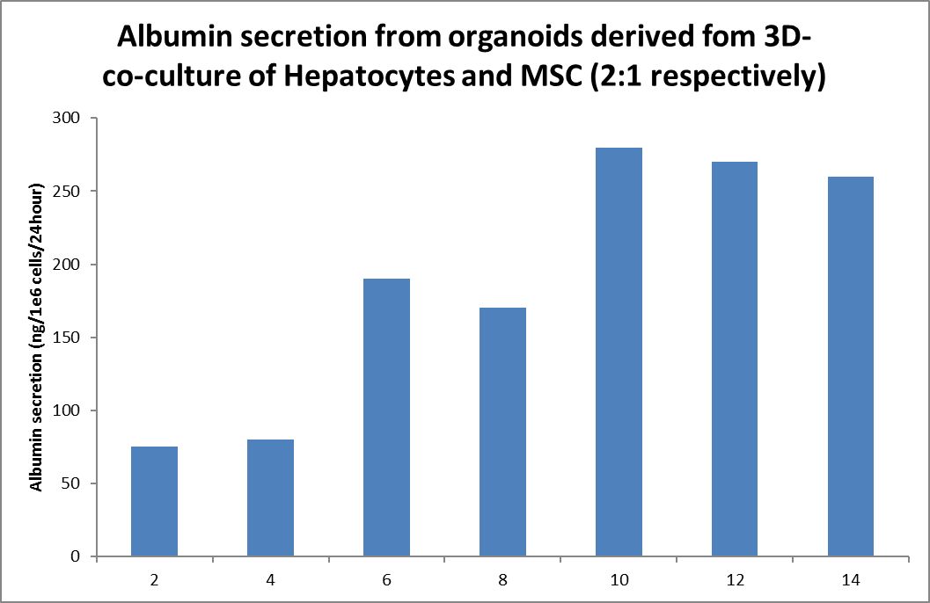
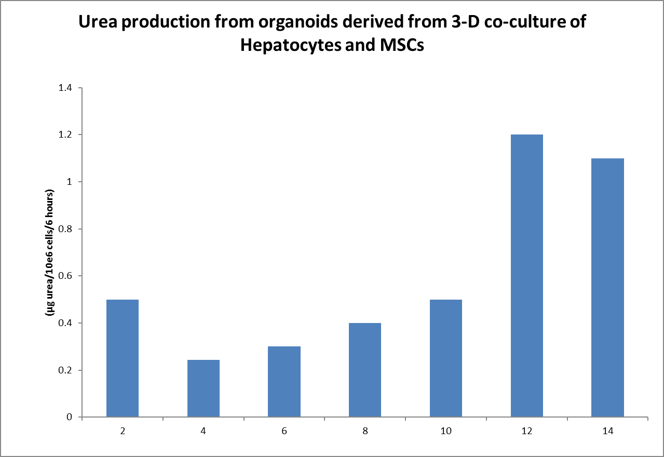
A
B
Figure S3

Slide 8
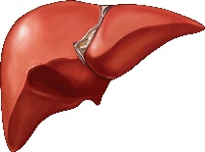
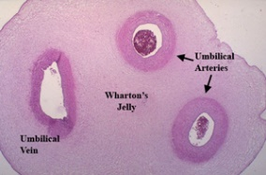




Liver-organoid development
Donor (consented)
liver
Umbilical
cord
(Consented)
Good Manufacturing Practise Compliant
Cannulation
Isolation of Mesenchymal
Stem Cells (MSC) from
Wharton’s Jelly by plastic
adherence
Collagenase Perfusion
Hepatocyte purification
Hepatocyte viability testing
And Cryo-preservation
Expansion of MSC and
Cryo-preservation
Thaw Hepatocytes
Thaw MSC
Determine viability
Determine viability
Culture 2:1 (Hepatocytes: MSC) in Methylcellulose(1.2%), DMEM/F12, N2,
B27 supplements and 10ng/ml TGF-β and EGF, for 14 days.
Initial experiments cultured in 96-well round bottom non-tissue culture
treated culture plates. Subsequently, optimised cultures scaled up to
non-treated 6- well plates. Resulting organoids then characterised by and for
Urea analysis
Albumin ELISA
Histological analysis
Figure S4

