Slide 1
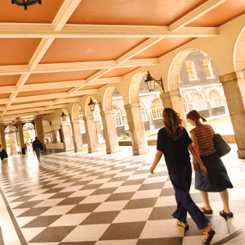
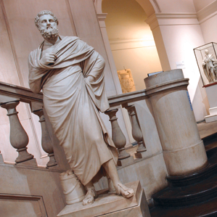
TBLT 2013
October 5th 2013 – Banff, Alberta
Where are the tasks? The (sad) case of MFL in the UK classrooms
Nick Andon
King’s College London
.
Notes:
MFL= Modern Foreign Languages (the teaching of French, Spanish, German, Mandarin in UK schools)

Slide 2
Two groups of teachers
“This paper compares the beliefs and practices of two very different groups of teachers in the UK in relation to their understanding and use of tasks and TBLT”.
Four teachers of EFL to adults in language schools in London (TBLT 2011, Andon & Eckerth 2009)
Teachers of French, German and Spanish as MFL to secondary school children aged 11-14 (Andon & Wingate 2013)
Notes:
When I put in a proposal for a talk I mentioned comparing beliefs and practices of two different groups of teachers in the UK in relation to their understanding and use of tasks and TBLT. As the title suggests though my focus is on one of these groups, teachers of MFL (Modern Foreign Languages) in secondary schools in the UK or rather, as the United Kingdom is not at all united when it comes to education, teachers of MFL in England. I will talk briefly though about another group of teachers and their principles and practices with respect to TBLT.
I talked at the last TBLT conference in Auckland about one group of teachers, working in private language schools in London teaching EFL to adults. Clearly here the learners are motivated enough to pay for the experience, they are spending some time in London immersed in the language, they have several hours of classes a day. I argued that these were optimal conditions for TBLT, not only because of the situation of the learners, but also the well resourced context, the fact that the teachers were experienced and qualified and had plenty of opportunities to learn about TBLT, and also the fact that they enjoyed a great deal of autonomy to choose the approach. If TBLT can be found anywhere, one would expect to find it in this context. I spoke about 4 case study teachers, the way they used tasks, and the extent to which their approach could be considered TBLT at the last conference in Auckland.

Slide 3
Context 1: EFL teachers in language schools
Learner-centred lessons. Learners as active communicators, acquisition rich environment.
Use of tasks, task-like activities.
Language (some of the time) derived from task requirements, post task focus on form
(Some) knowledge of TBLT principles, focus on outcomes, task repetition, outcome evaluation and providing models of task performance. HOWEVER
Combine TBLT with PPP & focus on formS approaches.
Did not accept tasks as knowledge-creating devices.
(Andon & Eckerth 2009)
Notes:
These teachers not only had a certain amount of knowledge and understanding about TBLT, they also demonstrated aspects of TBLT in their practice. Interestingly, the 4 teachers claimed different amounts of knowledge of TBLT and different attitudes towards using it in their contexts. However it seems that there are more similarities than differences and in a sense their shared community of practice may account for this even though they all work in different institutions. The slide shows some of the ways in which their practices, and the principles underpinning them relate to TBLT.

Slide 4
Context 2: Teachers of MFL at KS3
7 mid-career teachers of secondary school teachers of French, German & Spanish
MFL compulsory only at KS3 (age 11-14)
More than 50% discontinue MFL at age 14
Slow progress, lack of motivation & low attainment partly due to methodology
Analysis of 13 lessons mainly KS3
Interviews with teachers pre and post observation
Analysis of materials and other curriculum docs.
Notes:
The context of the other group of teachers is very different. Peter Skehan uses the analogy of conscripts and volunteers to describe differences in the learners in these context. Unlike the adults in context 1, the children in Context 2 are not usually learning a language by choice. It is compulsory to go to school and in school learning a modern foreign language is compulsory up until year 9 (age 14). It used to be for longer but in 2003 the policy in England changed so that it is no longer compulsory beyond KS3. As a result, since 2003 the number of pupils studying modern foreign languages (MFL) beyond the compulsory period of three years at Key Stage 3 (KS 3) has decreased dramatically. More than half of allpupils drop foreign languages at age of 14 which it is argued, gives them a considerable disadvantage in terms of their intellectual development, their intercultural understanding, and their life and career opportunities (Coleman, 2009). The current decline in MFL study also contributes to the social divide, as grammar schools and independent schools maintain relatively high levels of participation, while in less privileged schools, far more pupils drop languages at the end of KS3. To provide equal opportunities to all pupils, it is crucial to identify ways in which pupils can be motivated to continue the study of MFL beyond the age of 14.
Reasons are complex and include the status of English as a World language and the perception that languages are difficult and we Brits are no good at learning them anyway. It is difficult to do much about some of the underlying causes. However we are convinced that methodology and content of lessons plays a considerable part, and that this is something where change ought to be possible.

Slide 5
Questions
What kind of activities and classroom practices characterise the approach to teaching in KS3 MFL classrooms?
What beliefs and principles in relation to teaching and learning languages are reflected in these classroom practices?
How do these principles and practices relate to current theories of second language learning and to TBLT?
Notes:
THEN With regard to the second question, understanding teachers beliefs or principles is increasingly seen as important in research on teaching, and key to changing teachers practices. In fact, unlike the EFL teachers in context 1, these MFL teachers talked about their principles in terms of techniques and orientation towards making the learners feel motivated, comfortable, having clear objectives, checking understanding, making learning fun They talked about lesson shapes and stages. No mention of approaches, of theories related to how young people learn language, learner autonomy, strategies. They had never heard of TBLT, PPP, sketchy knowledge of CLT with no particular affiliation to it. We needed to try to infer principles from practices.

Slide 6
Challenge of relating beliefs & practices to TBLT
Teachers’ knowledge about TBLT & level of understanding. Sketchy (EFL teachers) Zero (MFL)
Complexity of TBLT as an approach (Carless 2009).
Teachers don’t articulate their beliefs or align with one approach. No purist versions of an approach.
What makes TBLT task based? (Samuda). Lack of consistency in defining tasks, let alone TBLT.
TBLT not a matter of whether tasks are used, or what tasks, but how & why tasks are used.
Degrees of “TBLT-ness” inferred in teachers practices and the way they talk about their practices.
Notes:
There are a number of difficulties in trying to assess teachers’ attitudes to TBLT and the extent to which their practices relate to TBLT. These are listed on the slide. I’ll just focus on a couple. Firstly these teachers seemed to have absolutely no knowledge of TBLT. The extent to which TBLT had filtered down into their practice therefore needs to be inferred from what they do but also how they talk about what they do. However, it is far from straightforward to map practices onto TBLT. Ginnie Samuda’s question of yesterday: “What makes TBLT task-based?” is difficult to answer. Constanze Dressler came up with some helpful criteria or characteristics on Thursday: The creation of meaningful speaking opportunities, opportunities to experiment with language, allowing for creativity, less teacher centred and more peer interaction, opportunities for teachers to diagnose where learners are at and to provide the language learners need, and so on. My approach has been to hold data on teachers practices and principles up against a number of principles of SLL which are broadly in line with a task-based approach.

Slide 7
Principles for instructed SLL
Helpful/essential conditions for second language learning (Ellis, 2008; Macaro & Graham 2013; Tomlinson 2013; Dornyei 2013)
Predominant focus on meaning
Opportunities to focus on form
Rich and meaningful exposure to language in use
Opportunities for contextualised and purposeful communication in the L2
Opportunities to interact in the target language
Affective and cognitive engagement
Notes:
Recently a number of our colleagues have listed key principles for instructed second language learning. These include of course Rod Ellis’ principles which have been adopted in New Zealand for MFL, but also Brian Tomlinson’s in his 2013 book on SLA & Materials development which is an attempt to link theory and practice, and the output from Macaro & Graham’s recent MFL ESCR project. Another useful set of principles is from Dornyei’s principled communicative approach. Principles of course are general and can be operationalised in different ways but these principles are consistent with TBLT and to some extent it is revealing to use these as a lens to look at teachers’ approaches and then to be able to say something about the degree of “TBLTness”
It’s important to see these principles as interacting with one another. So, for example, combining 1 & 2 it is fairly well accepted that a focus on form is best done within the context of a focus on meaning
Exposure to language in use suggests authentic and meaningful reading and listening and that activities to accompany reading and listening texts should focus principally on extracting key meanings for a purpose.
4 & 5 are about output and again meaning is highlighted.
6th point suggests learners need to be interested in what they are reading and listening to but also to have some engagement with the things they say and write, they should be personally meaningful. It also suggests a level of cognitive challenge.
Macaro and Graham’s principles are a slightly different in that their interest is in strategies, but the last one which they stress as most important is that grammar should only be taught in the service of the skills, and not VV

Slide 8
Data collection/participants
1. MFL classroom observations (N = 13)
Languages: German: 8, Spanish 4, French 1
School types:
4 Academies (5 teachers)
1 (boys only) Grammar School (1 teacher)
1 Voluntary Aided All-Ability boys School (1 teacher)
2. Interviews with all teachers (pre-/post lesson)
Notes:
this is the data we collected. Categories of schools are in flux and I’m not sure if we have accurately captured this.

Slide 9
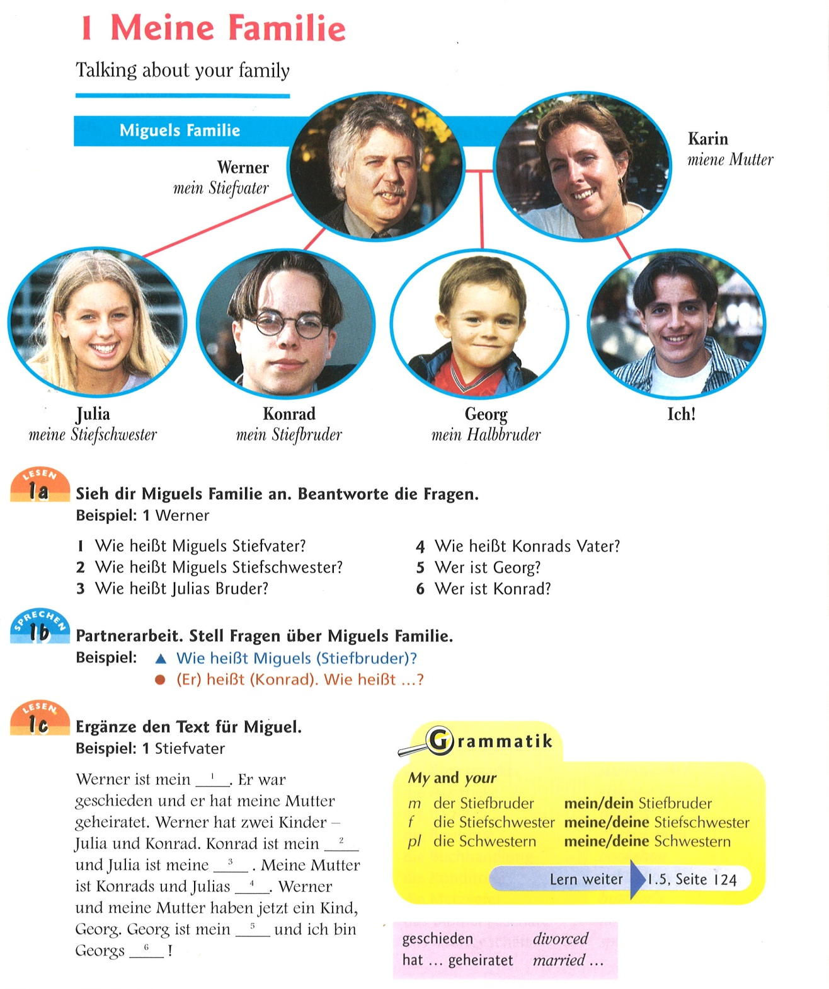
Extract from Lanzer 2002
Notes:
The first thing to be said is that the teachers are let down by the materials they use that don’t contain anything that resembles task. This activity which we saw a teacher use is from a widely used textbook and comes at the end of a second year of teaching German.
Unit 5 Lesson 1 has as its objective “Talking about your family”. It starts with a set of five small pictures representing Miguel’s family, captioned with first names and family relationships, for instance ‘Werner, mein Stiefvater’ [Werner my stepfather], ‘Karin, meine Mutter’ [Karin, my mother], ‘Georg, mein Halbbruder’ [Georg, my half brother]. Pupils are asked to answer written questions like ‘Wie heißt Miguels Stiefvater?’ [What is Miguel’s stepfather called?], ‘Wer ist Georg’ [Who is Georg?]. Then in pairs they are required to ask each other the same questions about Miguel’s family. It is hard to imagine a situation where pupils would need to ask each other the names of another pupil’s parents, but in any case they already know the answers, so this is pure language display. The format of the exercise lacks any challenge and can be completed without any understanding of what the target words mean. There is no requirement for pupils to do anything with this information, beyond filling in the relationship labels in a text consisting of Miguel’s own description of his family. “Werner ist mein ________” [Werner is my ________], and this again could be copied from the labelled pictures above without any understanding of the text.
It’s striking that thus far, not only is there no real task but also pupils have had no opportunity to talk about their own families. The language they have practised in the unit in talking about Miguel’s fictitious family is rather unnatural (Werner is my stepfather. Karin is my mother) and the models provided throughout the unit are without context or purpose. Who is describing their family to whom, and why are these questions being asked? What pupils are learning to say in German is simplistic (‘My mother is very funny. My brothers are totally annoying’) and lacking in educational value, cognitive challenge or affective engagement. Another exercise in this unit asks students to describe their family in a short, written text, and interviewing one another about their families which is suggested in the Teachers’ Guide as an extension exercise, but again there is no task, no outcome, simply output of text in a vacuum.

Slide 10
Opportunities to produce language
Your partner’s family
How good are you at names? Tell your partner about your family.
Start with your parents and then go on to your brothers and sisters.
Write the names of your partner’s family on a family tree.
How many names can you remember? Don’t look at your partner’s family tree! Which of you has the better memory?
Now write some sentences about your family. Then write some sentences about your partner’s family. Give your sentences to your partner to read and check.
Tell the class about your partner’s family.
(from Willis & Willis 1988 Collins COBUILD English Course Student’s Book 1).
L2 learning requires extensive opportunities for meaningful output (e.g. Ellis 2008, Lightbown 2000, Tomlinson 2013)
Interactional authenticity
Situational authenticity
Personal authenticity
Limited value of exercises and drills which lack these
Notes:
If the writer of the textbook, or the teacher using it, had any wish to follow a task-based approach, it’s easy to see how this activity could be turned around. Here is one example from Willis & Willis 1987.
And here is another obvious task – start with a text (in German) and a blank family tree. It seems to me that the very reasons these kind of activities are not used in the UK are the very reasons why they would be used in TBLT: challenging, learners are exposed to language beyond their ability, they are expected to read and talk about a text even though they don’t know all the words and the grammar, they will need to think, they will need to experiment with language and take risks in order to communicate meanings.

Slide 11
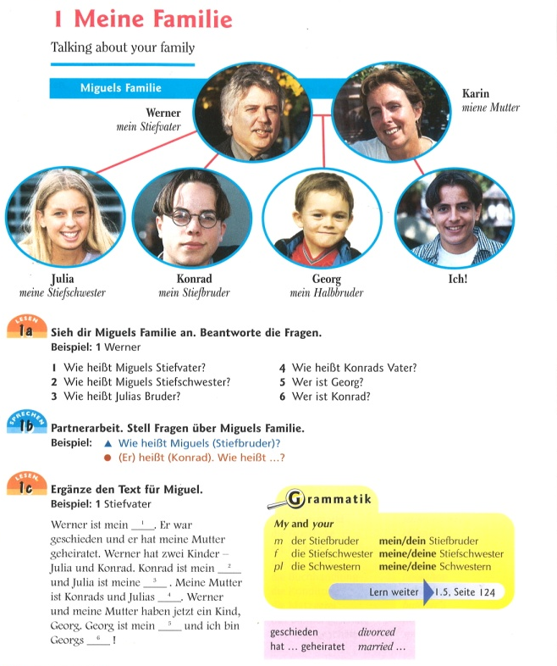
Johanns Familie - taskified
My mum is called Chloe and she is a teacher. She married my stepfather, Jeremy, four years ago, when I was 9 years old. Jeremy was married before and he already had two children, Louisa and Michael. Louisa, my stepsister is 15 and Michael, my stepbrother is just one year older than me.
Oh, and I have a baby brother, well, half brother really, he’s called Martin and he’s one and a half years old. My real dad lives in Berlin, and he is a bus driver. He got married again and he has a daughter from his new wife. She’s called Julia and she is 3 years old and she’s my half sister. So you can see that my family is quite complicated.
Complete Johann’s family tree. Then complete these sentences about Johann’s family.
Notes:
See previous slide for notes

Slide 12
Working with a text –actual example
Jumbled cartoon strip on worksheet
Ich bringe eine grosse Flasche Cola zum Schulfest mit. Was bringst du mit, Klaus?
Ich bringe Chips mit, okay? Okay. Und du, Eva?
Ich bringe meine CDs und Kassetten mit. Aber was fur Music spielen wir?
Heavy Metal Musik. Oh nein bitte.
Discomusik. Uh, gefallt mich überhaupt nicht.
Rap. Tut mir leid, aber das ist so langweilig.
Haben sie vielleicht ein Idee,Herr Richter?
Aber sicher. Die Beatles und die Rolling Stones.
Wir machen auch eine Sixties Fete.
(Lesson extract HELEN lesson 2)
Activity (17 minutes)
Pupils cut out snippets of text
Teacher sequences with whole class
Pupils stick the bits of the conversation in their exercise books.
No comprehension or practice activities.
Notes:
Here is another piece of material, again based on a unit of the book towards the end of the second year of German and here is what the teacher does with it.
It’s a pretty odd text but fairly typical – it was presented to students on a handout in the form of a cartoon strip, 9 boxes with pictures of the speakers, but in a jumbled order for students to sequence. On the face of it a reasonable activity to practise the lesson aim “deciding what to bring to a party”. And there is a strong task based element to the way the teacher uses the activity, with an outcome although a language focused one. Pupils can work together to sequence the jumbled text.
CLICK for part 2
In fact most of the pupils never really work on sequencing the text, don’t focus on the meanings or even the form, and don’t practise the dialogue
No comprehension work
Martien BERBEN yesterday afternoon pointed out that TBLT requires rich exposure, rich games, rich texts and I think rich opportunities to use language. This text itself lacks richness in its lack of authenticity but also lack of interest to pupils, but also richness of exposure is lacking in the way the activity was implemented, and certainly lack of opportunities to use language.

Slide 13
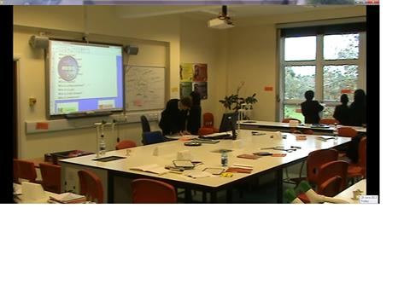
Use of games [1]: Treasure Hunt
Notes:
Game-like activities are used extensively by all these teachers and I would go along with the idea that what Martien Berben calls RICH games would be both appropriate and would fit well with TBLT. Actually I need to guess what Martien means by rich games, I presume that rich games provide quality and quantity of input, interaction and output, meaning and communication, and I would also assume that games need to be appropriate to learners age and general cognitive level as well as to their level of proficiency. This picture is of a game devised by the teacher to practise the language of jobs. We observed 3 or 4 versions of treasure hunts in different lessons. You can see that there are bits of text stuck around the room on walls and windows and the learners are going around with a task to complete.

Slide 14
Treasure hunt
10 texts stuck around classroom, e.g. Mon nom est Salim. Je travaille dans une garage. Je suis mécanicien.
Question on IWB/worksheet e.g. Who is a mechanic?
Task for student: identify name/type of occupation
Outcome: Pupils write down names, e.g. Salim
Time for activity: 15 min (+ 5 minutes set-up)
Notes:
As always the devil is in the detail and it is difficult to argue that this is a task or that it has much language learning value. There are problems with the decontextualised texts, with the pupil activity, with their output and with the level of challenge.

Slide 15
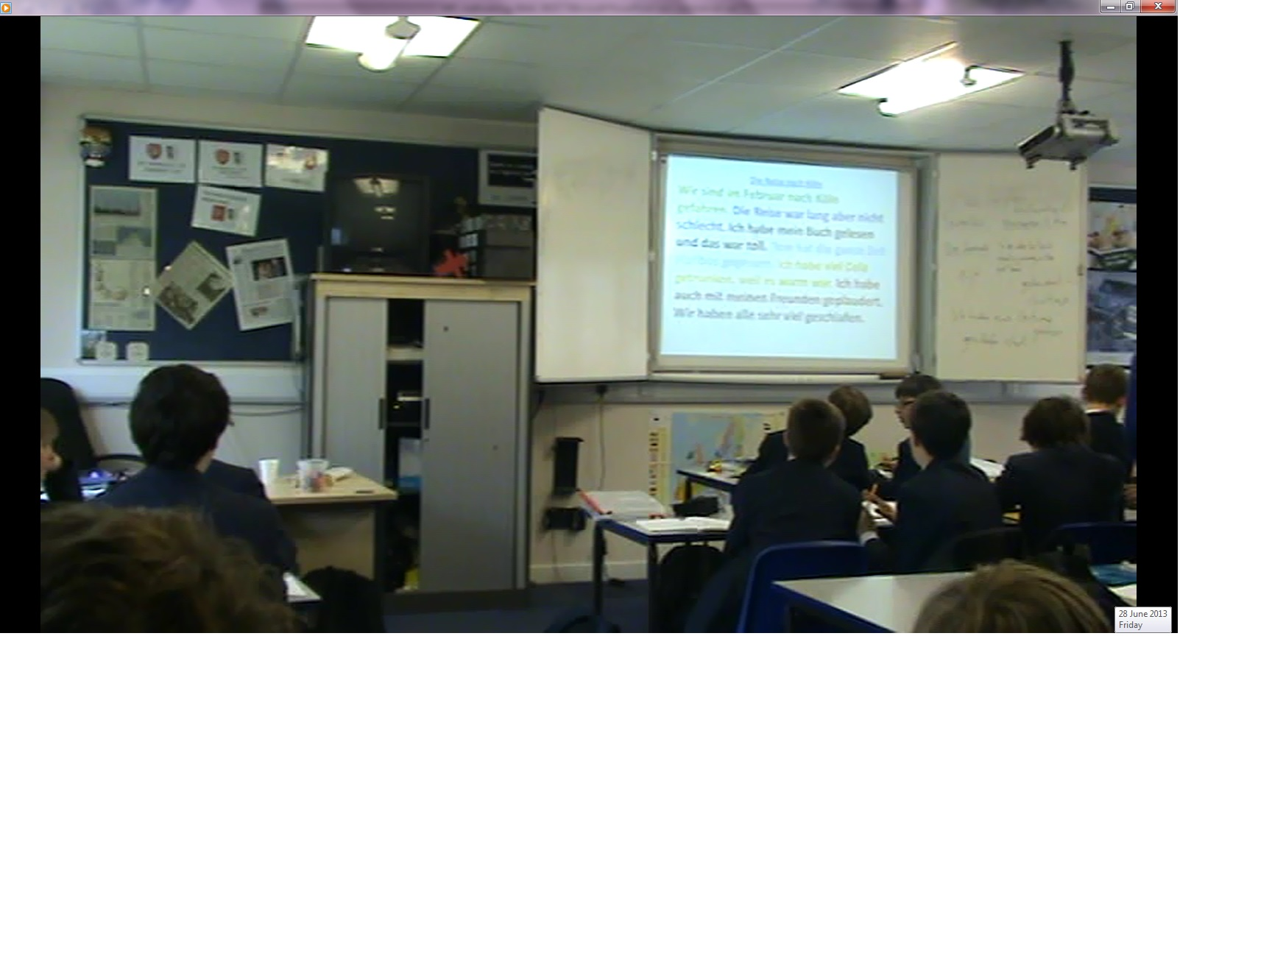
Use of games[2]: Red/blue/yellow sentences
Notes:
What we see on the whiteboard is a little dialogue, a conversation about a journey. You can see that the sentences are colour coded. The activity works like this. The teacher reads a sentence and the learners need to shout out the colour of the sentence. Then they play the game in pairs.

Slide 16
Principle 1 & 2: Focus on meaning vs. focus on form
Minimal attention to meaning in activities based on reading and listening texts (e.g. completion exercises; identifying colour of sentence).
No information gap, opinion gap, no need to find out anything from partner/group members. No tasks or problems to solve, no outcomes.
Focus on producing isolated, de-contextualised and untrue sentences to manipulate structures.
I don’t mind what they say as long as it’s in perfect German
Structures learned and practised in order to enable learners to communicate at some later stage.
Assessment based on demonstrating ability to use particular forms. Levels assigned based on tenses, opinions, reasons (relative clauses)
Notes:
PRINCIPLE 1 & 2 focus on meaning vs form

Slide 17
Principles 1 & 2: Focus on meaning/form
Alice ‘eventually the idea is that they can use and apply these structures in any context they wish but I think yes – at the moment they are very much at the practice stage’.
Understanding grammar is seen as empowering students to use language independently.
Notes:
PRINCIPLE 1 & 2 focus on meaning vs form. Alice argues that by providing structures, she is giving students a framework. A few of the teachers mentioned this idea that teaching grammar had gone out of fashion for a while, that within CLT pupils only learned set phrases, and bringing back a focus on grammar allowed learners to use the language independently to say what they wanted to. This is an interesting point but it seems that putting this grammar to meaningful use is expected to come much later.

Slide 18
Principle 3: Rich and meaningful exposure to language in use
No authentic materials, highly contrived examples
N: Where do you get them from, the readings?
T: I make them up, usually.
Snippets of texts, contrived listening comprehension, lack of context
No information on target culture. Simple, specially written texts about Harry Potter, English and American Films, fictional children describing their fictional and very unreal lives, activities, bedrooms, contents of bags, likes and dislikes, etc.
Notes:
In terms of the minimal amount of reading and listening pupils do, there is very little comprehension work. Any comprehension questions are usually obvious (Harry Potter wears glasses T/F, or which person in the listening plays football). More often though, little attention to meaning is needed to do the exercise anyway
In terms of speaking and writing nothing is communicated. The focus is on producing sentences to exemplify structures. As one teacher says … I don’t mind what they say as long as it’s in perfect German
Accuracy comes first, fluency and appropriacy are completely subsumed to grammar.

Slide 19
Ich bin ziemlich sportlich. Im Frühling spiele ich Tennis. Im Sommer gehe ich jeden Tag schwimmen.....Im Herbst ist das Wetter oft nicht so gut, also spiele ich mit meinen Freunden im Sportzentrum Basketball. Im Winter spiele ich in der Schule Fußball. Meine Freundin Lena ist nicht so sportlich. Im Frühling und Sommer geht sie einkaufen...Im Winter geht sie ins Kino oder sieht fern...
I’m quite a sporty person. In the Spring I play tennis. In Summer I go swimming every day. In Autumn the weather is often not very good, so I play basketball in the sports centre with my friends. In Winter I play football at school. My friend Lena is not very sporty. In Spring and Summer she goes shopping. In Winter she goes to the cinema or watches television.
Notes:
Anyone reading this text would not only be learning useful language but also getting a great insight into German culture. It seems that German teenagers stick to one activity for months on end. Also the weather in this part of Germany doesn’t allow kids to play outside in Autumn so Christian plays basketball indoors. Fortunately the weather in Germany gets a bit warmer again in the winter months allowing Christian and his friends to go outside again and play football.

Slide 20
Comprehension questions
What does Christian do in Winter?
What does Lena do in the Summer?
Is Lena sporty?
Even if the text had been authentic, from answering this type of question, what type of information do students learn that …
… they might find interesting;
… they might want to know;
… they could do something useful with?
Does it provide a good model for their own writing?
Notes:
And of course if you have a text you probably need comprehension questions
This wasn’t really the purpose of this exercise – it provided a model for students to talk about themselves. But although it provides useful language for talking about your own activities the ideas are not good models.
|Students don’t care about Christian and Lena’s activities because they know they are not real.
There is nothing they could do with this information – would you want to tell someone about this?

Slide 21
Hola. Me llama Harry Potter. Tengo los ojos azules y llevo gafas. Tengo el pelo corto, negro y liso. Soy delgado y un poco bajo. Soy muy simpatico y bastante inteligente, pero no soy guapo en mi opinion. Sin embargo mi amiga Hermione es muy inteligente y es tambien guapisima, pero a veces no es divertida. Tiene el pelo largo, castaño y rizado y tiene los ojos marrones. Me gusta mucho Hermione porque no es perezosa ni aburrida.
Verdadero o falso?
1. Harry wears glasses 4. Hermione is always funny.
2. He thinks he’s nice 5. Harry thinks she is boring.
3. He says he’s very intelligent

Slide 22
Principle 4 & 5: opportunities for contextualised and purposeful communication and interaction in the L2
Language production largely restricted to:
-one-word answers (repeating, translating, filling in gaps)
-creating decontextualised sentences using target structures:
Say what you did on a train journey
Say what you would like to change about your home town (and why)
Make a sentence about what you are going to do in order to be more “green”
Write 3 sentences about your bedroom
Activities: no communicative purpose, no negotiation of meaning,
little use of target language.
Assessment: produce a sentence containing an opinion, more than one tense, relative clause expressing reason
Pair and group work used to complete exercises – interaction
entirely in English.
Notes:
Also don’t seem to see language in terms of the 4 skills Reading Listening Writing and Speaking even though this is highlighted in NC
Pupils try to give silly answers in order to personalise what they may see as pointless exercises where there is no need to stick to reality.

Slide 23
Principle 6: affective and cognitive engagement
Activities: no link to pupils’ personal experience
Attempt to engage pupils with incentives:
Sweets, points and gimmicks
Games
Lack of challenge
Fear of turning students off with hard work
Fear that students will perceive languages as difficult
Notes:
Gimmicks include throwing stuffed animals around the class,

Slide 24
Fun and games (Extracts from interviews)
I think it’s a little bit like a Butlin’s red coat so you could imagine it’s jumping around in the front of the class being quite loud and engaging and trying to enthuse the most unwilling participants to get involved
I do a lot through games, competition and offering positive rewards so for example I always have students’ names on the board with whichever class it is with ticks for participation and then the carrot for these donkeys is that they will have positive phone calls, postcards or sometimes there will be prizes
I’ve been to training days where they tell you to make everyone do a dance across the classroom chanting and I think oh not in a million years am I gonna do that
Notes:
Principle 6: affective and cognitive engagement

Slide 25
Conclusions
Teacher interviews - no reference to language learning theories
Overwhelming focus on structures and vocabulary in interviews and observed lessons
Accurate production of forms (of increasing complexity) prioritised over communication and meaning
Clear similarities between these 7 teachers
Teacher principles and practices in line with the assessment system, inspection regime and national curriculum guidelines and reflected in teaching materials (e.g. Andon & Wingate 2013).
Notes:
These MFL teachers do not talk about their principles in terms of either theories of language learning or approaches like CLT, TBLT or lesson frameworks like PPP
Also don’t seem to see language in terms of the 4 skills Reading Listening Writing and Speaking

Slide 26
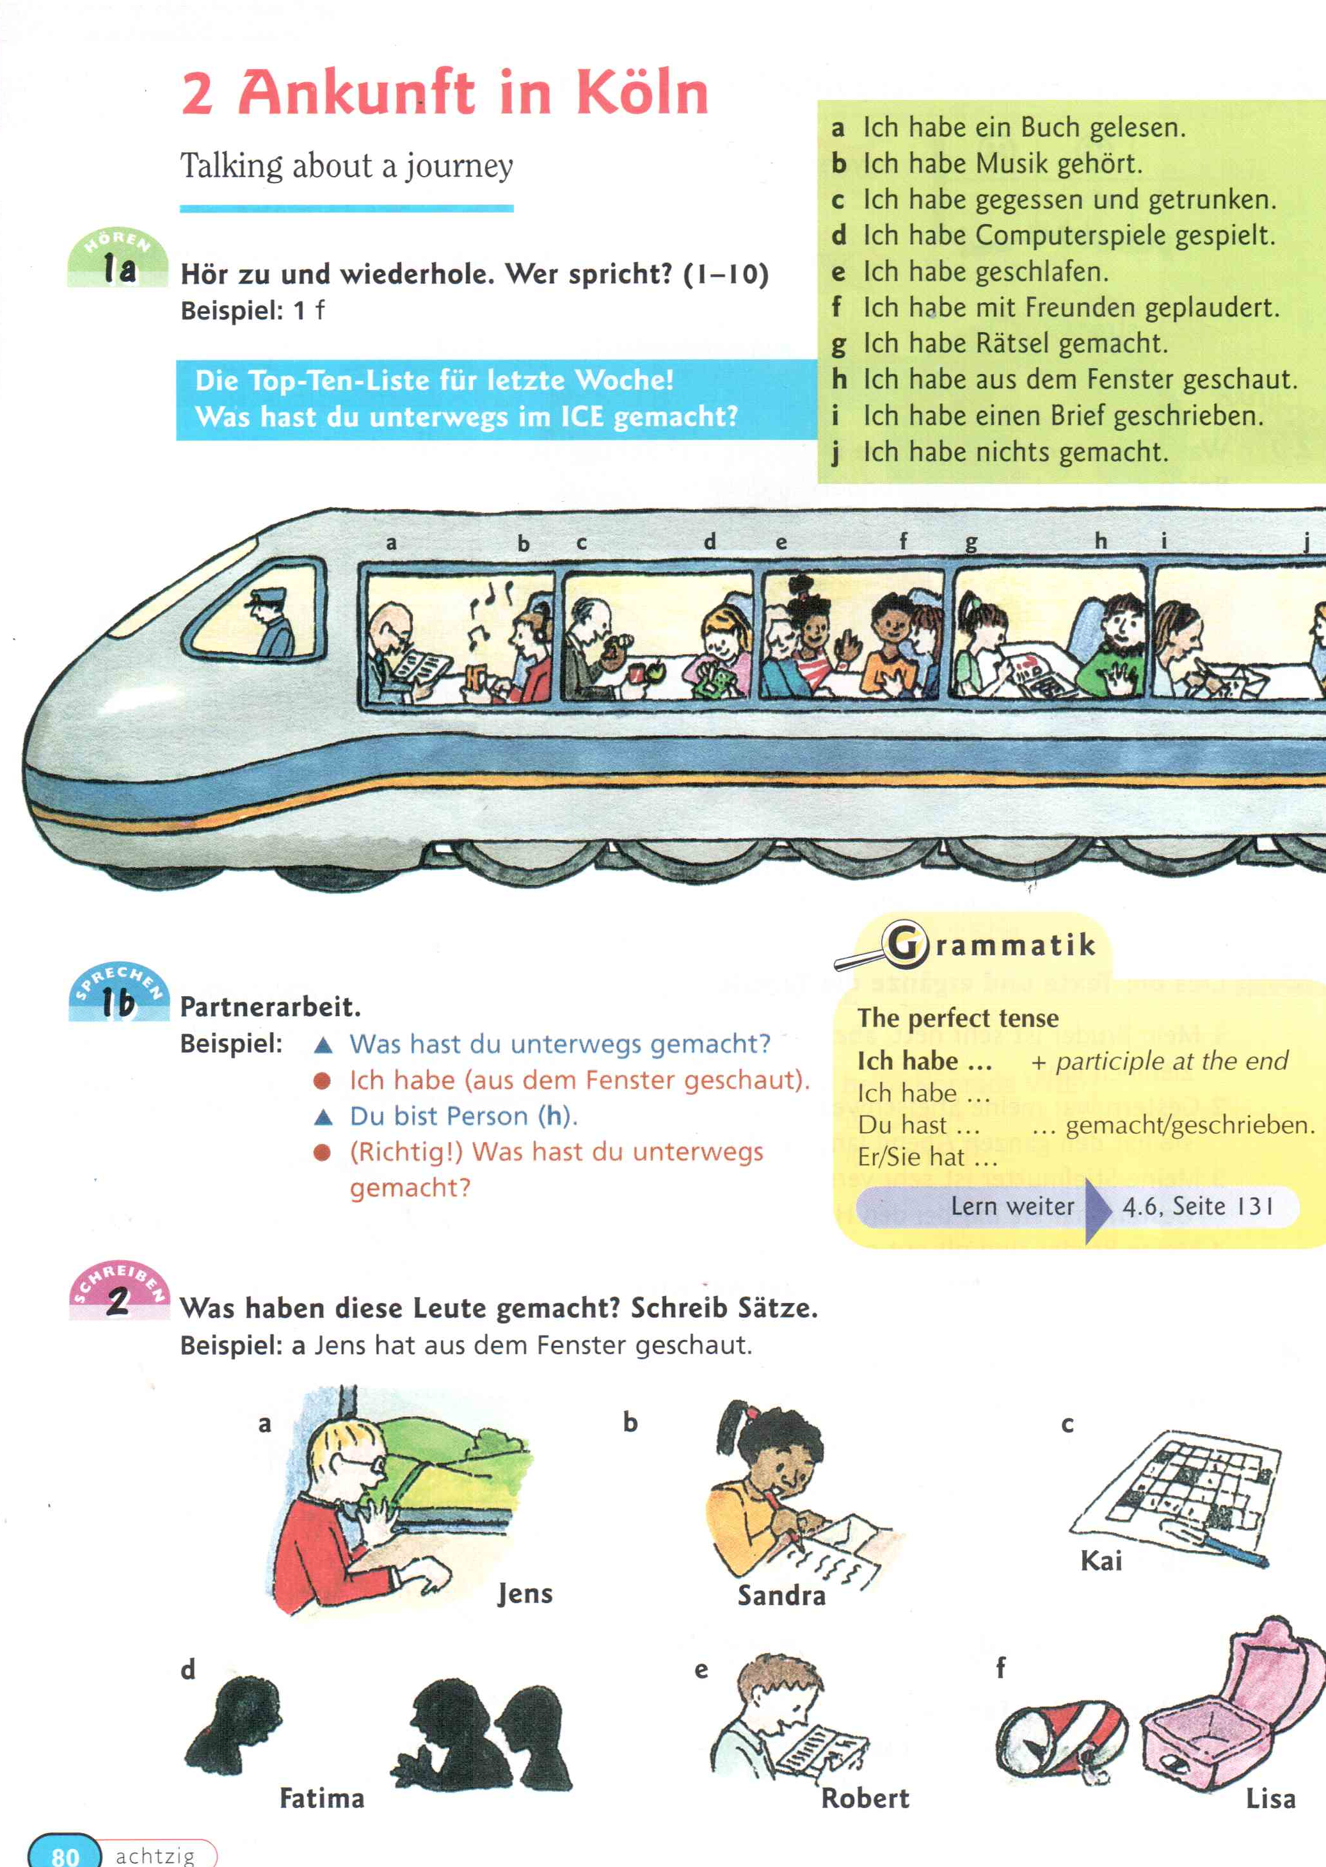
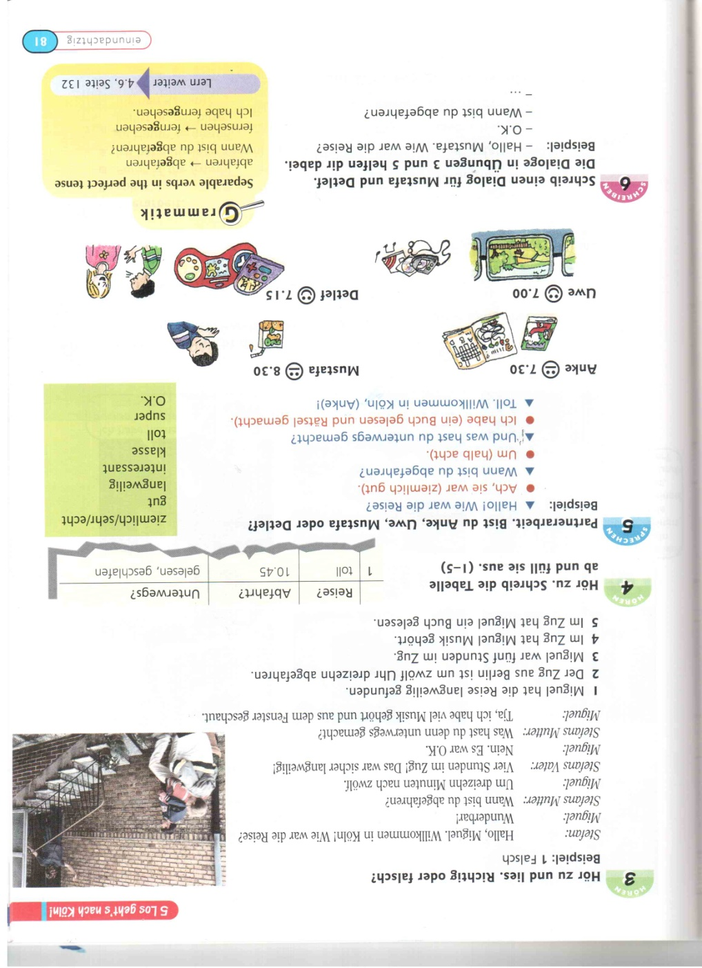
Speaking activities in Logo 2 U5 (handout)
Notes:
NICK (using handout)
Situational authenticity. Attempts to contextualise 1a & 3. But situational authenticity is lacking in that the purpose of these conversations and their contexts are not clear, and even if they were, they are not very natural situations.
Interactional authenticity. Semantic but not pragmatic meaning. Nothing is communicated except perhaps “see if you can recognise from what I say which person in the picture I am pretending to be. The model dialogue is stilted in order to arrive at the target structure: What did you do on the journey? I (drank some orange juice). Nothing is communicated between pupils in the pairwork, and they speak in complete grammatical sentences instead of providing the information asked for in a natural way.
Personal authenticity is missing from this whole set of activities on 5 levels:
Pupils don’t get to use their own ideas or to talk about their own experiences or ideas. (interestingly pupils we observed working with this unit made up crazy ideas – I played basketball etc.).
In fact they don’t even gt to talk about themselves. The minitest on the next page says Check that you can: say what you did on a journey? Talk about a journey. Interestingly at no point in this lesson do learners get to talk about what THEY did on a journey. They talk about person abcdefghi & j in a picture, and they talk about Jens,Sandra, Kai, Fatima, Robert, Lisa, Anke, Mustafa, Uwe and Detlef.
They have no choice over what language they use
The topics are not of great personal relevance or interest
The functional situations are not ones that learners are likely to see as important for their future lives
The “texts” they produce lack naturalness not only in the language but also in the discourse structure – learners would recognise the activities as practising grammar not learning to communicate. Would anyone really ask someone what they did on a journey, and would you say “I drank coca cola” or “I played computer games (from the 1980s!)” or “I looked out of the window”?
Does it matter?

Slide 27
Talking about a journey
Objective – say what you did on a journey
On the train I played cards/looked out of the window/drank coca cola/chatted to my friends
Labov’s structure of Western narratives tells us that a story that has a point to it. Abstract, orientation, complicating action, coda evaluation. Why would anyone tell a narrative about a journey where nothing happened?

Slide 28
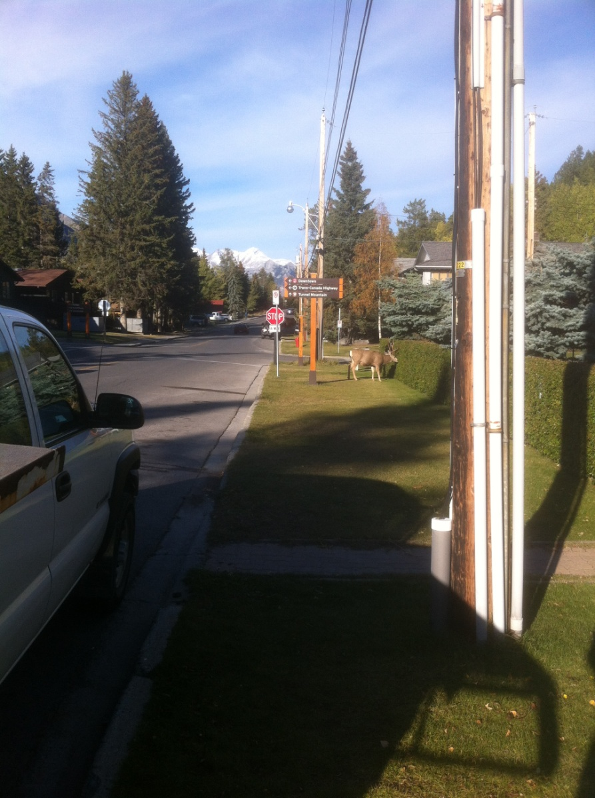
Unless ...
Something unusual happens.
I was walking home last night, just minding my own business

Slide 29
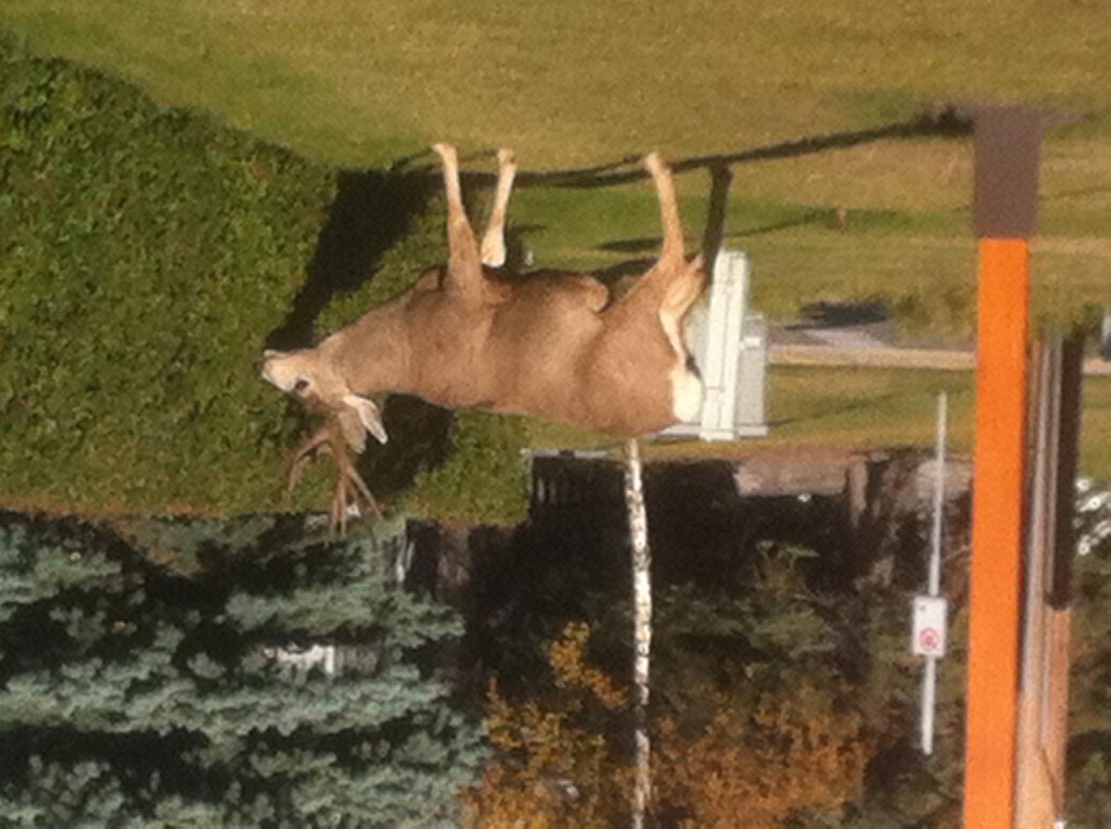
When I almost bumped into...

Slide 30
references
Andon, N. & Eckerth, J. 2009. Chacun à son gout? Task-based L2 pedagogy from the teacher's point of view. International Journal of Applied Linguistics 19 (3): 286-310.
Andon, N. & Wingate, U. 2013. Motivation, authenticity and challenge in German textbooks for Key Stage 3. In Gray, J. (ed.) Critical Perspectives on Language Teaching Materials. Palgrave Macmillan.
Dörnyei, Z., 2013. Communicative Language Teaching in the twenty-first century: The ‘Principled Communicative Approach’. In Arnold, J. and Murphey, T. (eds.) Meaningful Action: Earl Stevick's Influence on Language Teaching. Cambridge: Cambridge University Press. 161-171. DOWNLOADABLE FROM www.zoltandornyei.co.uk
Ellis, R. 2008. Principles of instructed second language acquisition. CAL Digest December 2008.
Gordon, A. & Lanzer, H. (2002a) Logo! 1 Pupil’s Book Oxford: Heinemann.
Graham, S. & Macaro, E. 2013. PDC in MFL: Research for Language Teaching. Downloaded from http://pdcinmfl.com/ on 12/07/2013.
Green, J. & Lanzer, H. (2002b) Logo! 2 Teacher’s Guide Oxford: Heinemann.
Lanzer, H. (2002) Logo! 2 Pupil’s Book Oxford: Heinemann.
Lightbown, P. (2000). Anniversary article. Classroom SLA research and second language teaching. Applied Linguistics 21 (4): 431-462.
McNeill, J. & Williams, S. (2004) Echo 1 Pupil’s Book Oxford: Heinemann.
McNeill, J. & Williams, S. (2005) Echo 2 Pupil’s Book Oxford: Heinemann.
Tomlinson, B. 2013. Second language acquisition and materials development. In Tomlinson, B. (ed.) Applied Linguistics and Materials Development. London: Bloomsbury Academic.
Willis, J & Willis, D. 1988. Collins COBUILD English Course Student’s Book 1. London: Collins ELT.

