Slide 1


TRANSPORTATION SECURITY CONSIDERATIONS OF
SMALL MODULAR AND MOBILE REACTORS
Dr Ross Peel, M.Eng. George Burnett, M.Eng.
Research and Knowledge Transfer Manager Strategy and Security Advisor
Centre for Science and Security Studies Nuclear Transport Solutions Ltd.
King’s College London

Slide 2
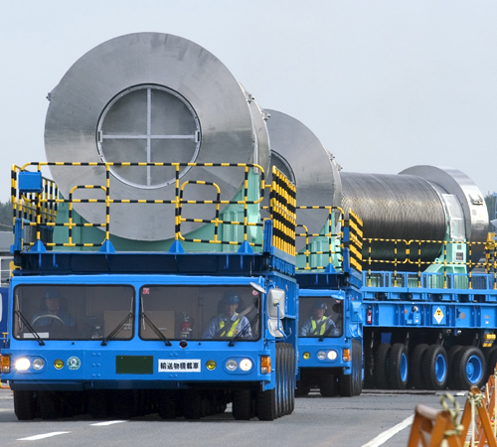
Agenda
Context and transport security fundamentals
Legal/regulatory frameworks
Unique features of SMR
Transport security considerations
Novel approaches in transport
Transportable Nuclear Power Plants
Recommendations
Matt Herod, “Transport of nuclear fuel in Japan”, 2004, https://blogs.egu.eu/network/geosphere/2015/02/02/geopoll-what-should-we-do-with-radioactive-waste/

Slide 3
Context
Drive towards small modular reactors (SMR)
  A range of oft-discussed benefits
More reactors, more sites, more countries
  ~200 units by 2035 (UK NNL, 2014)
Many potential impacts
    Supply chains, export controls, construction times, investment risk, etc.
    Transport and security
Talking about SMR
  Also touch micro, Gen IV, transportable
 | ≤10/30/50 MWe | >~30 – 300 MWe | >300 MWe
Gen II or III | N/A | N/A | Large conventional Nuclear Power Plant (NPP). Possibly with modular approaches for Gen III+.
Gen III+ | Micro-reactors | Small Modular Reactor (SMR)
Gen IV | Advanced micro-reactors | Advanced (modular) reactor (AMR)

Slide 4










Transport Security Fundamentals
Security:
  Prevent theft, sabotage, access, transfer, etc.
Based on realistic, worst-case scenarios
  Threat description from competent authority
    E.g., piracy against ship carrying spent fuel
Nuclear fuel cycle requires transport
  Different than designing security for a site
  Multimodal – air, sea, river, rail, road
  Physical protection system for each operation
Similar underlying principles
    Graded approach
    Defense in depth
More info in IAEA Nuclear Security Series 26-G
Threat
Consequences
Vulnerabilities

Slide 5
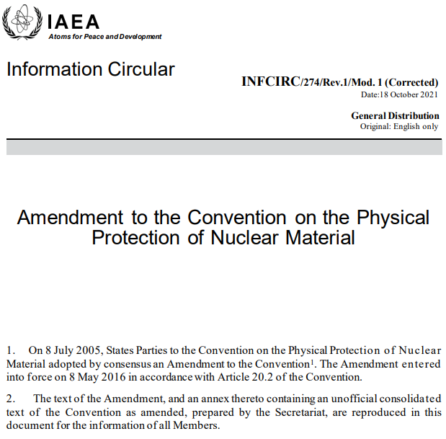
Legal and Regulatory Frameworks
Only two international legal instruments
  “Convention on the Physical Protection of Nuclear Material” (CPPNM) 1979, in force 1987
    Physical protection of nuclear material in international transport
    Amendment to CPPNM, 2005, in force 2016.
    Much broader than original CPPNM, covering all aspects of nuclear security
  States Parties still decide how to implement
  Quantities and types of material, and required measures, are detailed in annexes
INFCIRC/274/Rev.1/Mod.1 (Corrected), latest text of the Amendment to the CPPNM, 2021, https://www.iaea.org/publications/documents/infcircs/convention-physical-protection-nuclear-material

Slide 6
Unique Features of SMRs
Applications
Greater flexibility regarding siting
New nuclear states
Complete Reactor Transport
Transportable reactor systems
Broad range of fuel cycle lengths
Nuclear Material
Variety of SMR fuel cycle lengths
Novel fuel types proposed

Slide 7
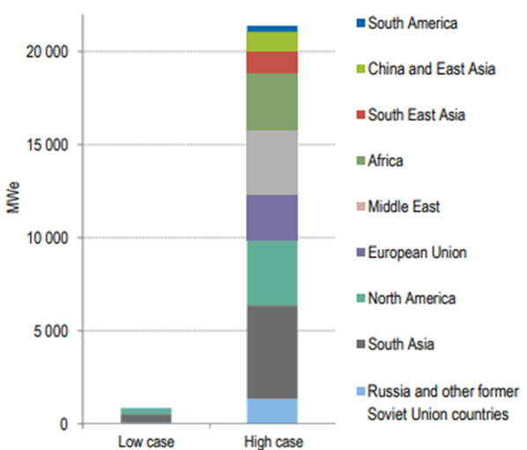
Transport Security Consideration 1 – More Transport Operations
Potentially many SMR deployments in coming years
  Each requiring initial and ongoing transport
    More countries, more sites, more units
    Types of SMR installed – more/less refuels
    Storing fuel onsite or transporting away?
Challenges:
    Many states lack experience of nuclear transport and associated security
    More reactors, but more distributed
    Quantitative market assessments needed, but likely that transport operations will increase
Modified image, taken from: “Small Modular Reactors: Nuclear Energy Market Potential for Near-term Deployment”, OECD Nuclear Energy Agency (2016), https://www.oecd-nea.org/upload/docs/application/pdf/2019-12/7213-smrs.pdf

Slide 8
Transport Security Consideration 2 – Materials of Higher Risk
Novel fuels in advanced reactors
  “High Assay LEU”: up to 20% U-235
  Thorium fuel cycles with U-233
  Plutonium-bearing fuels
Higher category => Greater security
  Need for more security in transport
Is current categorisation too simple?
  Doesn’t account for chemical or physical form proliferation resistance
Factory-sealed Cores
  Potential for criticality in sabotage?
  Holistic security assessment required
    Vital Area Identification method
Material | Enrichment | Category I | Category II | Category III
Pu, U-233 | N/A | ≥2 kg | 500 g – 2 kg | 15 g – 500 g
U-235 | ≥20% | ≥5 kg | 1-5 kg | 15 g – 1 kg
U-235 | 10-19.9% |  | ≥10 kg | 1 – 10 kg
U-235 | <10% |  |  | ≥10 kg
Irradiated fuel | N/A |  | Depleted or natural U, Th or LEU with <10% U-235
Data from Table 1 of: “Nuclear Security Recommendations on Physical Protection of Nuclear Material and Nuclear Facilities (INFCIRC/225/Revision 5)”, IAEA Nuclear Security Series No. 13, International Atomic Energy Agency, Vienna (2011). https://www.iaea.org/publications/8629/nuclear-security-recommendations-on-physical-protection-of-nuclear-material-and-nuclear-facilities-infcirc/225/revision-5

Slide 9
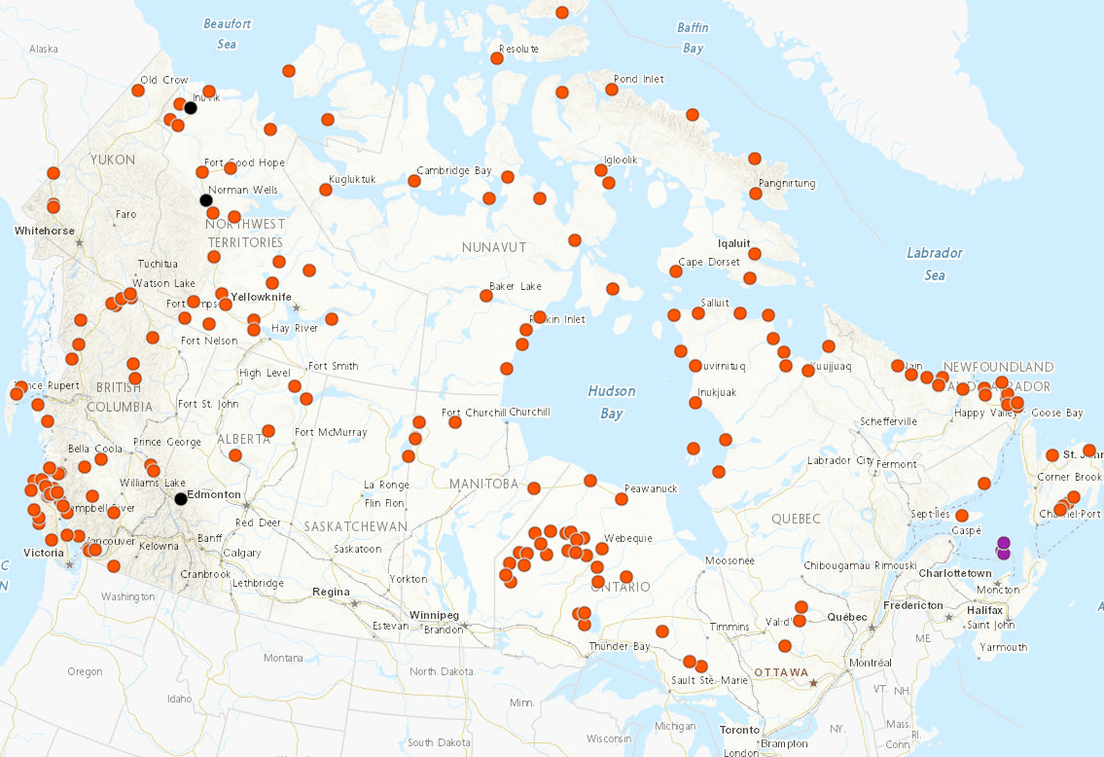
Transport Security Consideration 3 – Isolated and Remote Siting
Remote siting means new, less known routes
  Route analysis against threat statement
    Cat I/II – consider whole route security situation, and ensure response forces
Balance shortfalls in response availability
  Guarantee detection, SOS, and delay attackers
Some transport modes may be unavailable
  Backup routes and safe havens could be limited
Consider intermodal and loading points carefully
  Vulnerable points require security
Remote communities in Canada dependent on diesel fuel (orange), natural gas (black) and heavy oil (purple). Image taken from Jimmy Thompson, “Is Canada betting big on small nuclear reactors? Here’s what you need to know”, The Narwhal (2021).
https://thenarwhal.ca/canada-smr-nuclear-reactors-explained/
Map originally prepared using the “Remote Communities Energy Database”, Natural Resources Canada, https://atlas.gc.ca/rced-bdece/en/index.html

Slide 10
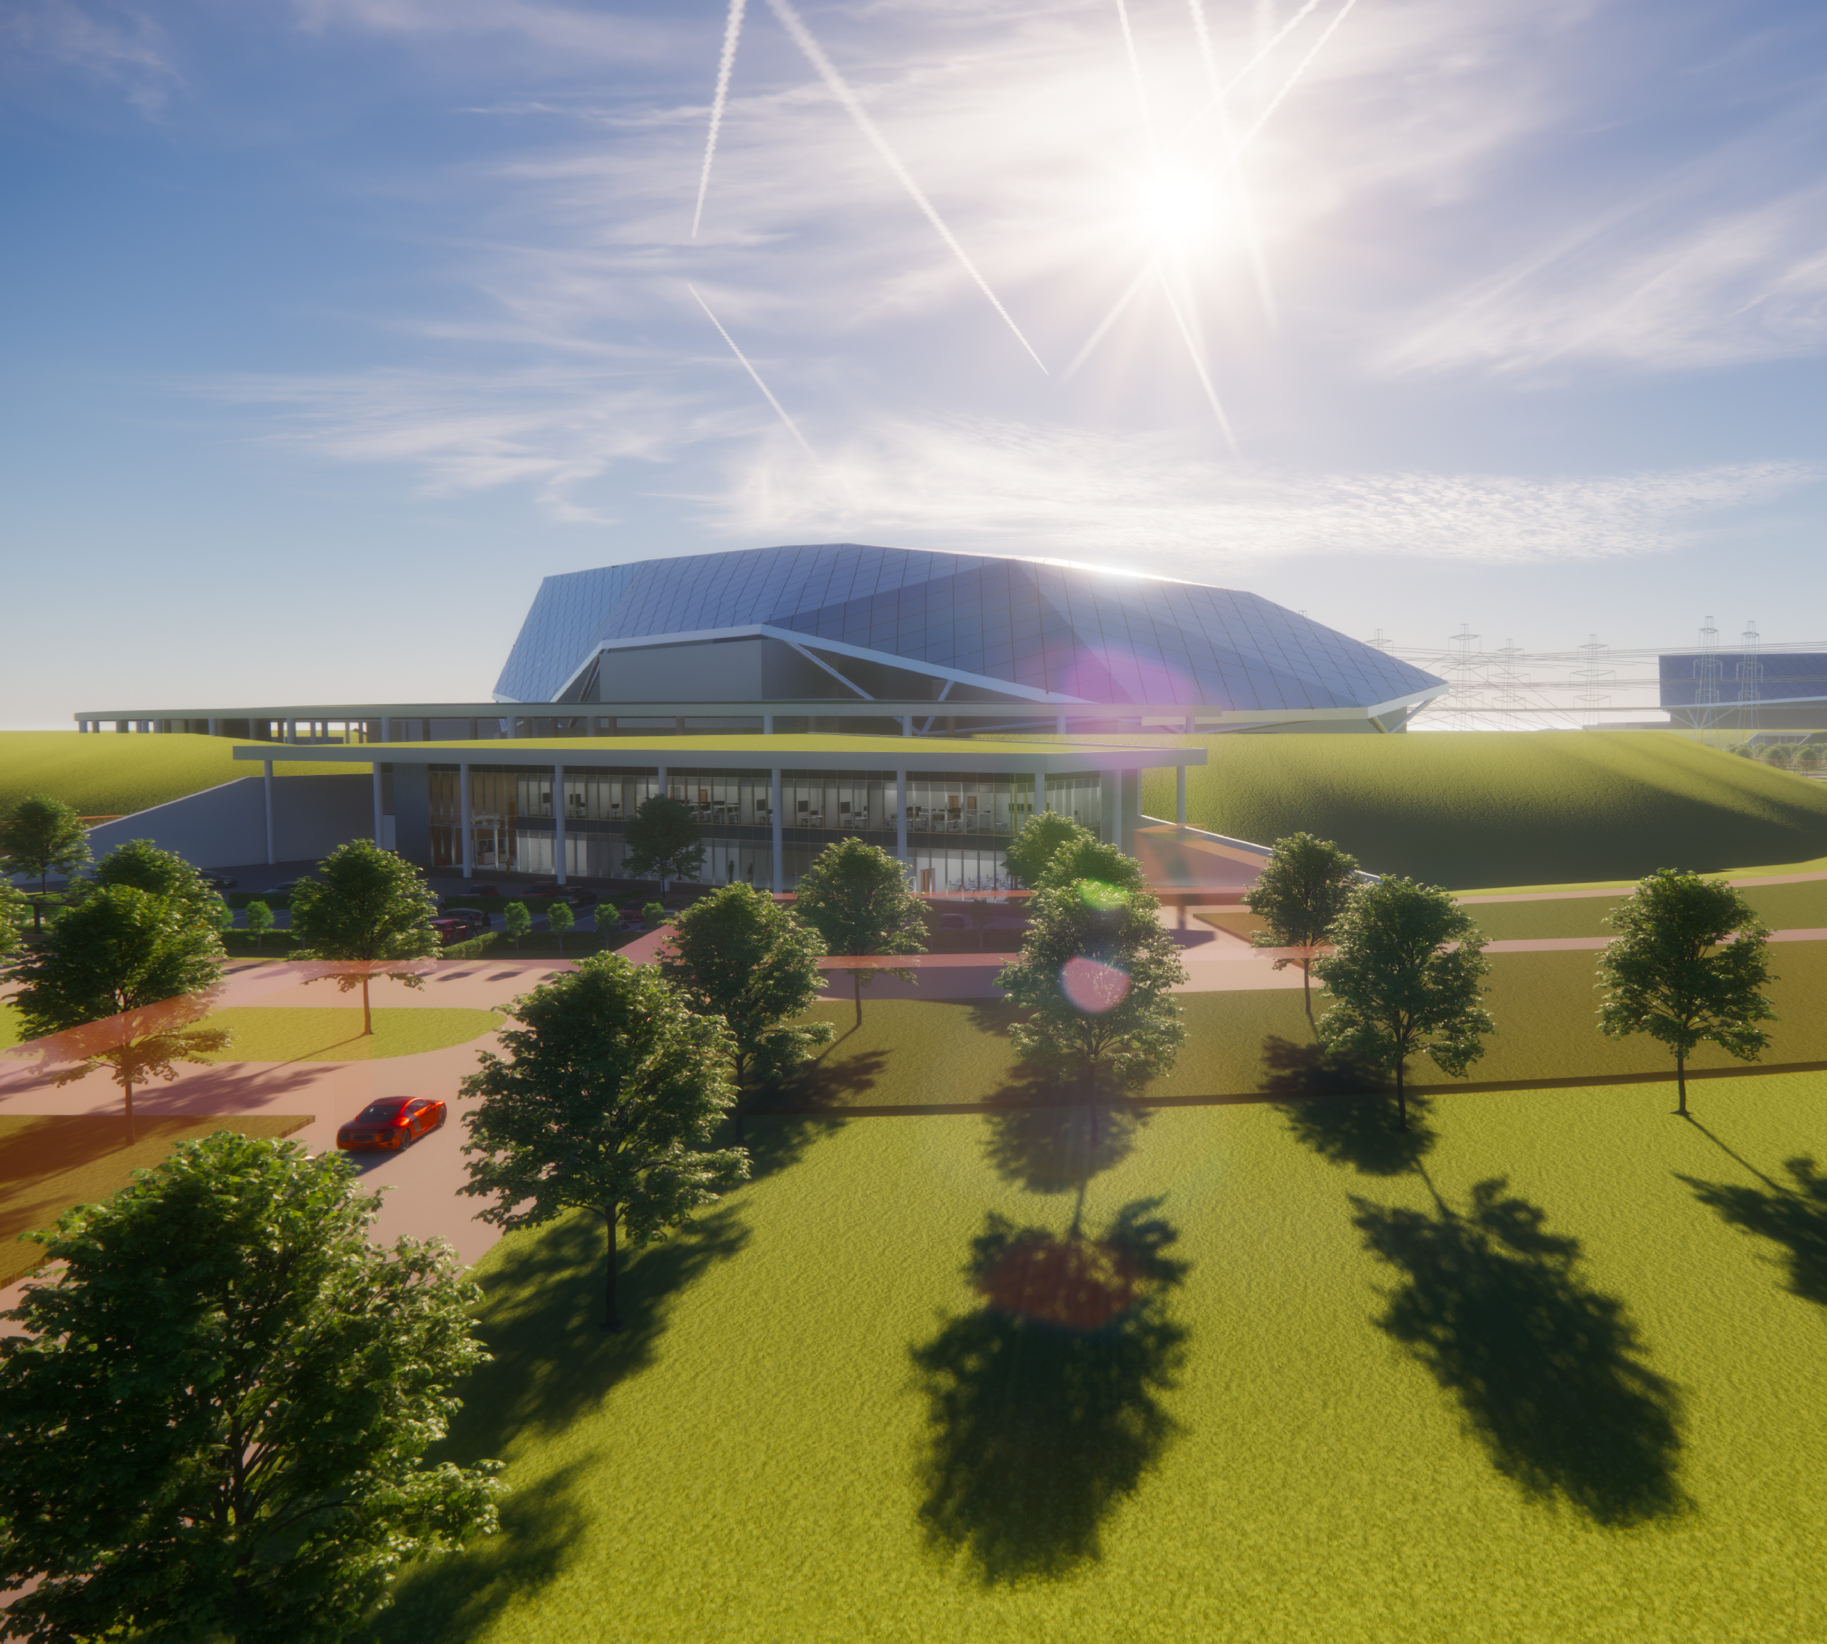
Transport Security Consideration 4 – Legal/Regulatory Frameworks
New guidance required from IAEA & Member States
  A/CPPNM and current guidance of limited use
  Some new operational elements, e.g. remote sites, movement of fuelled reactors
States encouraged to sign (A/)CPPNM
  Reassures IAEA and international partners
  Not a requirement – provisions for transport to/from/within non-signatories exist
Regulatory development required in some states
  Guidance on preparation for A/CPPNM signing
  Not just for transport security
Computer generated render showing an external view of the UK SMR concept under development by Rolls-Royce. Image provided with permission from Rolls-Royce Holdings PLC.

Slide 11
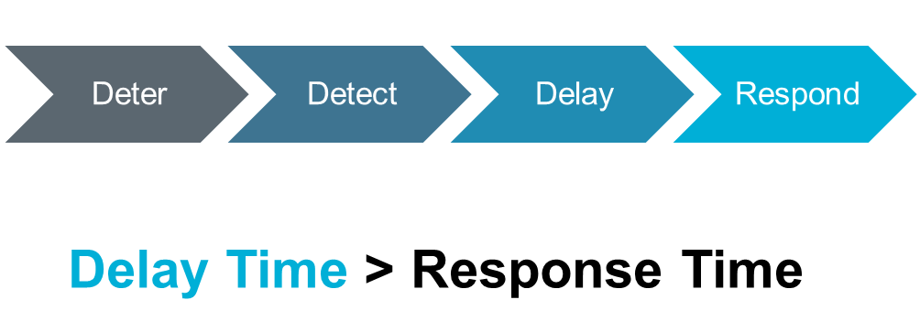
Novel Approaches to Transport
Underlying principles are unchanged
  Assess threat, route, cargo. Secure as needed.
SMR unique features create new requirements
    Secure-by-design equipment can give security credit, reducing burden in transport
    Analysis needed on material/equipment performance in attack scenarios
International transport requires engagement
  All states on route are responsible for security
  Engagement needed to ensure all are satisfied
  Cat I requires Records of Discussion (RODs)

Slide 12
Specific Challenges for Transportable Nuclear Power Plants
TNPPs have additional security considerations
  SMR issues + transport issues + synergic effects
  Self-contained operation: no site boundary
  Design in detection and delay
Mobility has pros and cons
  Unlikely to be agile – creates hijack scenario
  Can retreat from beyond design basis threats
Additional legal/regulatory elements
  E.g. maritime law for floating NPPs
  Developers must ensure compliance with both.
  Assess early & often to address regulatory gaps.
Previous IAEA work, now working to update
  New TECDOC expected 2022/2023
Transportable NPP issues
Nuclear power plant
Equip-ment transport
Materials transport
Mobile platform
Self propelled? How?
Intern-ational mobility
Unique vulnera-bilities
Road/sea/ etc. law applies

Slide 13
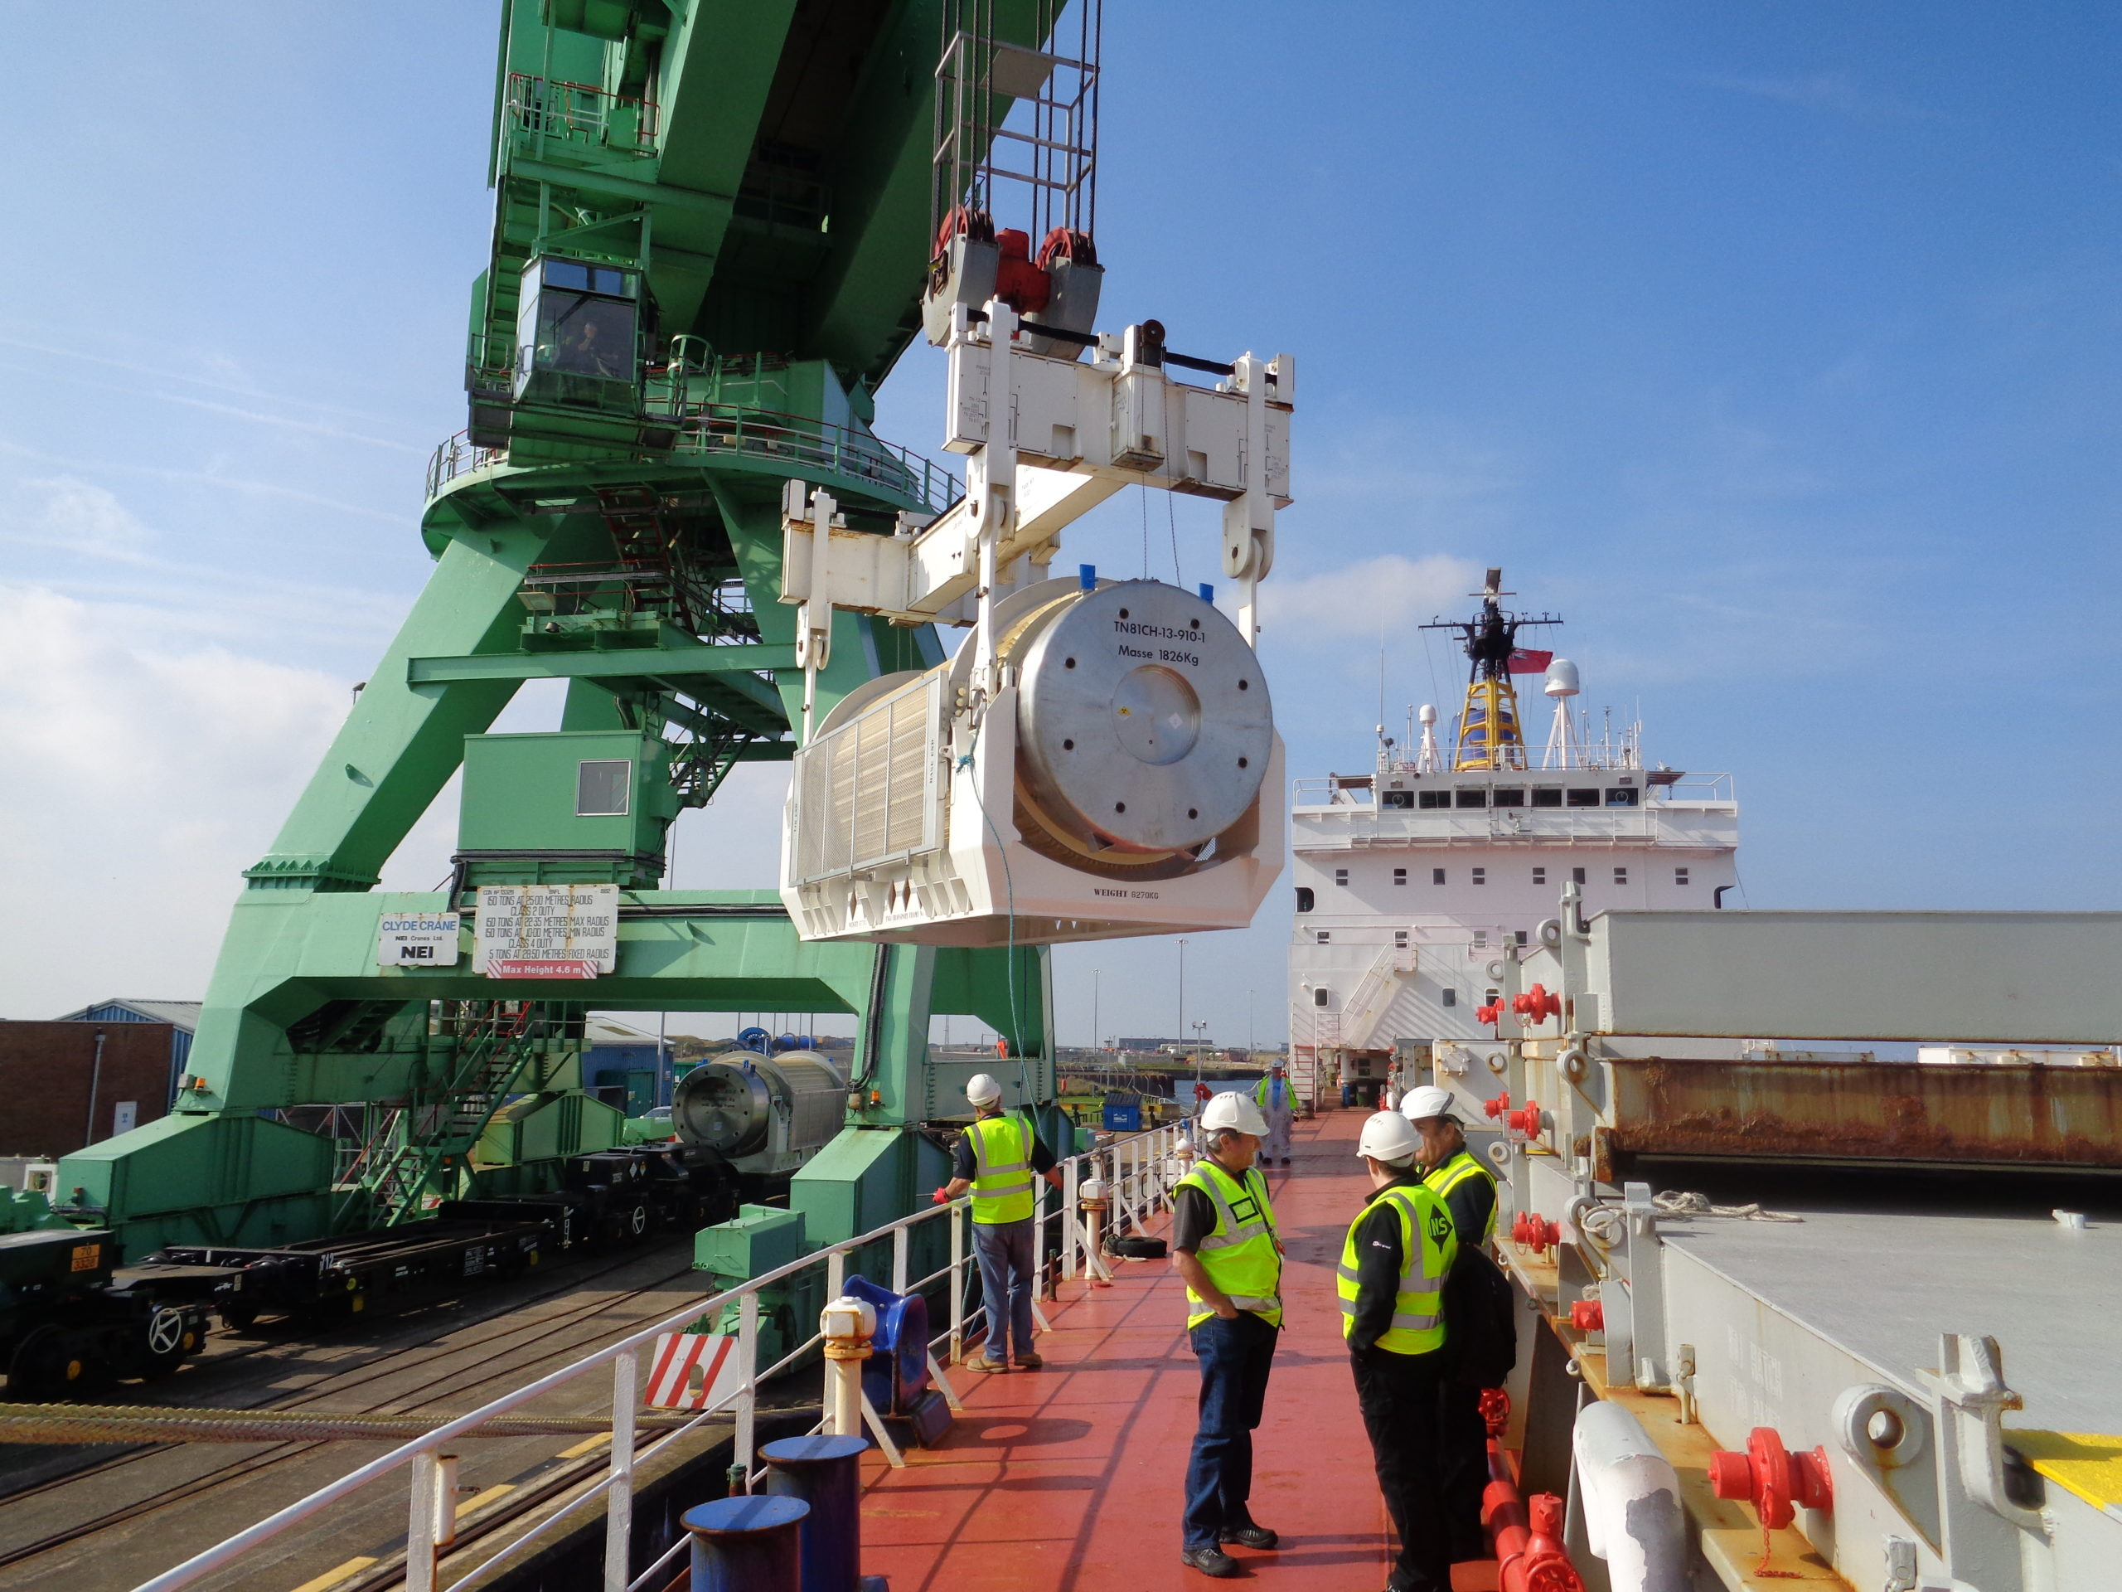
Conclusions and Recommendations
Legislation OK, but new guidance needed
    Early ‘blank slate’ security assessments needed to tackle novel elements of SMR design
    Failing to design-in security at low cost will push burden onto operators, where high cost
Aim for cooperation in transport security design
    SMR designers should work with transporters to mitigate novel challenges and use novel solutions
    Remove vulnerabilities + build in detection & delay => control transport security costs
Aim for holistic, integrated 3S design
    Maximise mutual benefits and mitigate conflicts early
UK loading operation taking place for maritime transport of Cat I nuclear material.
Image owned by Nuclear Transport Solutions.

Slide 14
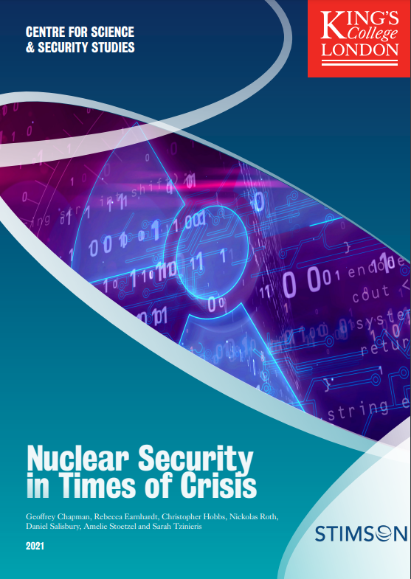
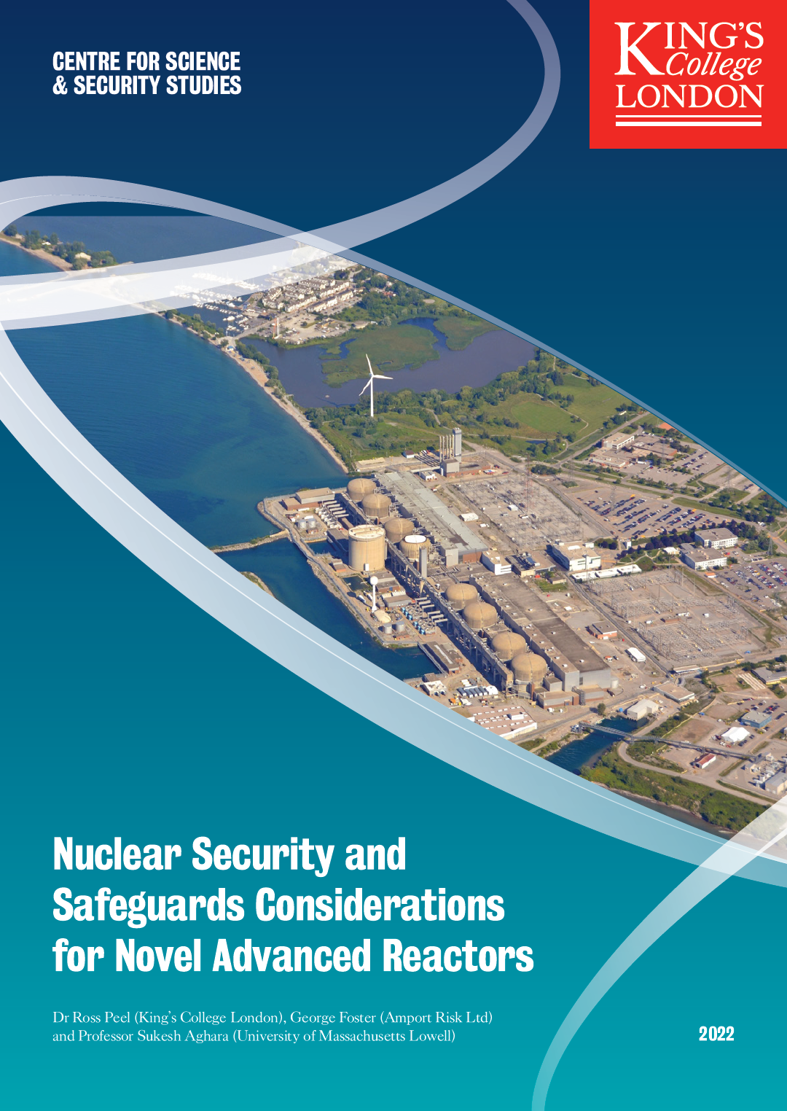
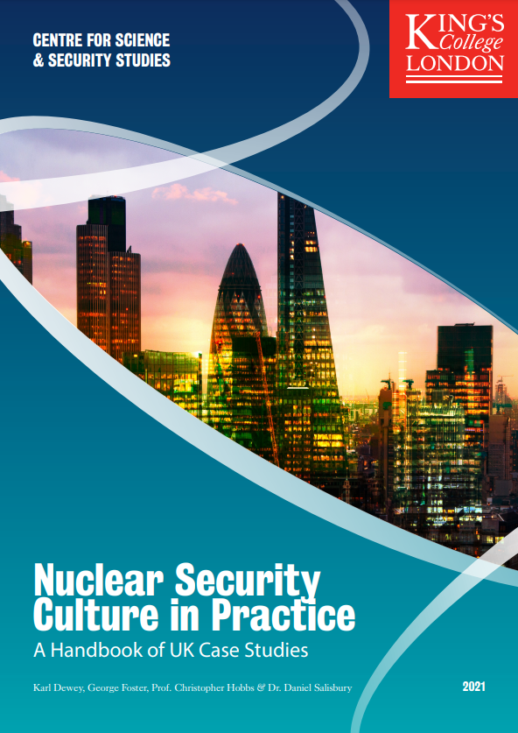
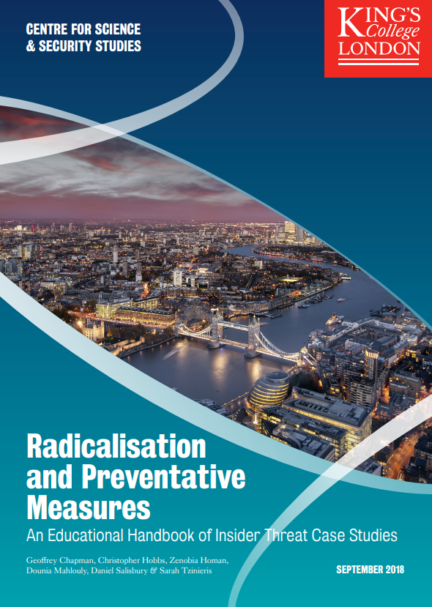
Report on Wider Security and Safeguards Considerations for EID
Can be found online:
  https://bit.ly/KCL-EID-report
  Other Nuclear Security Culture Programme publications are also available through the King’s College London “Centre for Science & Security Studies” website: kcl.ac.uk/csss

Slide 15
Contact details/for more information
Dr Ross Peel
+44 (0)20 7848 9708 ross.peel@kcl.ac.uk www.kcl.ac.uk/people/dr-ross-peel
LinkedIn: ross-peel
Twitter: @DrRossPeel
This work was Financially Supported by the STFC Nuclear Security Science Network
Thank you
© 2022 King’s College London. All rights reserved.
Third party images remain the property of their respective copyright owners.

